Slide 1
The CCS Career Professional Development Journey

Slide 2
Our CPD philosophy
At CCS we believe in investing in the professional development of all our staff. Regardless of one’s stage in their career, professional development is essential to ensure that, as a workforce, we continue to provide the very best education for our young people, whilst also giving our staff the skills to move forward in their careers.
Regardless of our individual ambitions and ideals, we are united in one common goal; to give our young people the very best start in life. Effective CPD enables us to achieve that aim. We want every student and member of staff to be ambitious, confident and successful and believe that everyone can be a High Performer.
Our new CPD programme allows staff to develop in a more bespoke way and create their own path for their continued progression.

Slide 3
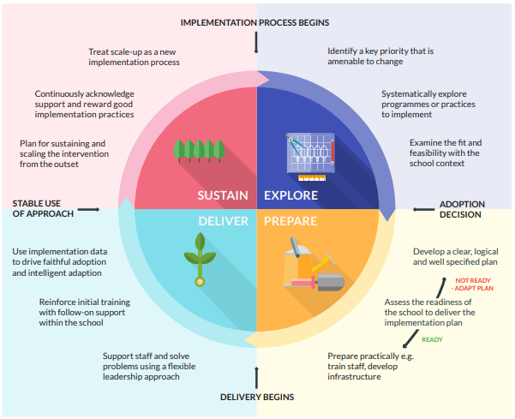
Effective Professional Development
The EEF (Education Endowment Foundation) recommends, in their ‘Effective Professional Development’ report:
When designing and selecting professional development, one must focus on the mechanisms (e.g. drawing from various sources, goal setting, action planning, affirmation and reinforcement, self-monitoring)
Ensure that professional development effectively builds knowledge, motivates staff, develops teaching techniques, and embeds practice
Implement professional development programmes with care, taking into consideration the context and needs of the school

Slide 4
New and improved
Enables staff to develop in areas that most interest them
Supports school priorities
Gives staff flexibility to work their CPD around their individual schedules
Enables staff to choose methods that inspire and motivate them
Challenges staff to continue their learning and development
Rewards staff for their efforts
CCS Professional Development Journey

Slide 5
Opportunities
Generic (not credit based)
Whole staff training days – the core requirements for all staff e.g., KCSIE
Team Meetings where CPD is shared
Focused CPD and Training
ECT Programme – including our July induction programme
External CPD – e.g., exam board courses
Golden Thread – e.g., NPQ qualifications
HPL Qualifications
ITT and ECF
Leadership and Facilitation
Pastoral, SEND and Inclusivity
Researcher Roles
Teaching and Learning
Technology and Innovation
Standard Annual Expected Commitment | 0.85-1 FTE Credits Needed | 0.74-0.84 FTE Credits Needed | 0.5-.073 FTE Credits Needed | 0.49 or lower FTE Credits Needed
Credits Needed | 60 credits | 50 credits | 40 credits | 30 credits
Staff are asked to choose from a variety of areas for their focused CPD and training.

Slide 6
We encourage staff to do more than the standard commitment, and rewards are available for those who go above and beyond with their focused CPD and training
CPD Milestones
CPD Hero
CPD Champion
CPD Star
Standard Annual Expectation
Level | 0.85-1 FTE Credits Needed | 0.74-0.84 FTE Credits Needed | 0.5-.073 FTE Credits Needed | 0.49 or lower FTE Credits Needed | Our Recognition and ‘Thank You’
CPD Bronze Standard Annual Expected Commitment | 60 credits | 50 credits | 40 credits | 30 credits | Successful sign off of CPD section on school appraisal record
CPD Silver | 90 credits | 80 credits | 60 credits | 50 credits | £25 gift card
CPD Gold | 120 credits | 110 credits | 80 credits | 70 credits | 0.5 day off school, on a day to be agreed with SLT
CPD Platinum | 150 credits | 140 credits | 100 credits | 90 credits | Day off school, on a day to be agreed with SLT

Slide 7
Golden Thread
The 'golden thread' refers to high-quality evidence underpinning support, training and development available throughout a teacher's career
Trainee Teacher
Early Career
Experienced teachers and middle leaders
Senior & Executive leaders, Heads
Who?
Initial teacher Training (ITT)
Early Career
Specialist Development
Leadership Development
What?
ITT Framework
Early Career Framework (ECF)
Specialist NPQs
Leadership NPQs
Type
QTS Awarded
Successful Completion of induction programme
Leading Teacher Development
Leading Teaching
Leading Behaviour
Leading Literacy
Senior Leadership
Headship
Executive Leadership

Slide 8
Cadets
We have a very successful Cadets programme at CCS. This relies on staff who are willing to support the programme and train to be part of the delivery.
The opportunity to be part of the Cadets programme applies to teaching and support staff – we would love to have more of the latter on board moving forward.
Each training course will carry credits.
Please liaise with Iain Rayner if you would like to know more!
10 Credits

Slide 9
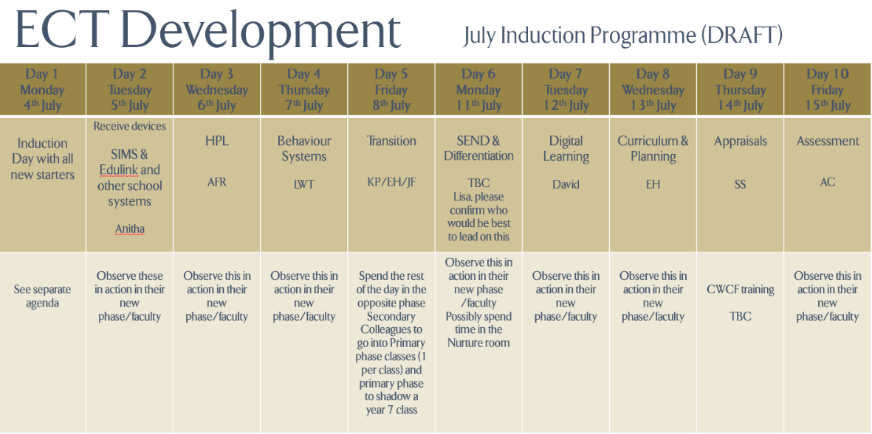
Early Career Framework
Early Career Framework Teachers in their first or second year of teaching are known as ECTs. CCS offers a Full Induction Programme - one that was revised for July 2022. ECTs are linked to the Northamptonshire Teaching School Hub.
Jonny Kirk is our ITT coordinator. Jonny provides bi-weekly training for our ECTs which supports their module learning on Brightspace.
Completion of the Brightspace modules and 60+% attendance at the training sessions is required.
All ECTs are given a mentor who will support them during their first two years of teaching. A member of the leadership team, or Jonny, will act as the Induction Tutor for each ECT.
Kat Wittich-Jackson is the ECF lead for the school.
10 Credits (Mentor)
40 Credits (ECTs)

Slide 10
External CPD
Sometimes it is necessary to seek training externally, such as: courses to inform staff about exam specification changes, new courses that we are running here at CCS, Ofqual changes and so on.
Any external CPD needs to be agreed with the leadership link for the faculty, phase or team and booked via Annie Whitehead.
Where staff do receive external CPD, for example, to learn about changes to a course, the expectation is that they will then lead CPD for the relevant staff (usually their phase, faculty or team). In doing this, we continue to share good practice and everyone learns.
10 Credits

Slide 11
First Aid Training
We currently have a team of reserve first aiders who act like super-heroes, attending to needs across our site when our full time first aiders are not available. We can never have too many people on this team and many hands make light work for all involved.
If you are a non-student facing member of staff (not a teacher, TA or LSA) and would be willing to do the relevant training and be part of the first aid team you would join the rota for first aid call response.
Being part of the reserve first aid team will come with a renumeration of £200.
30 Credits

Slide 12
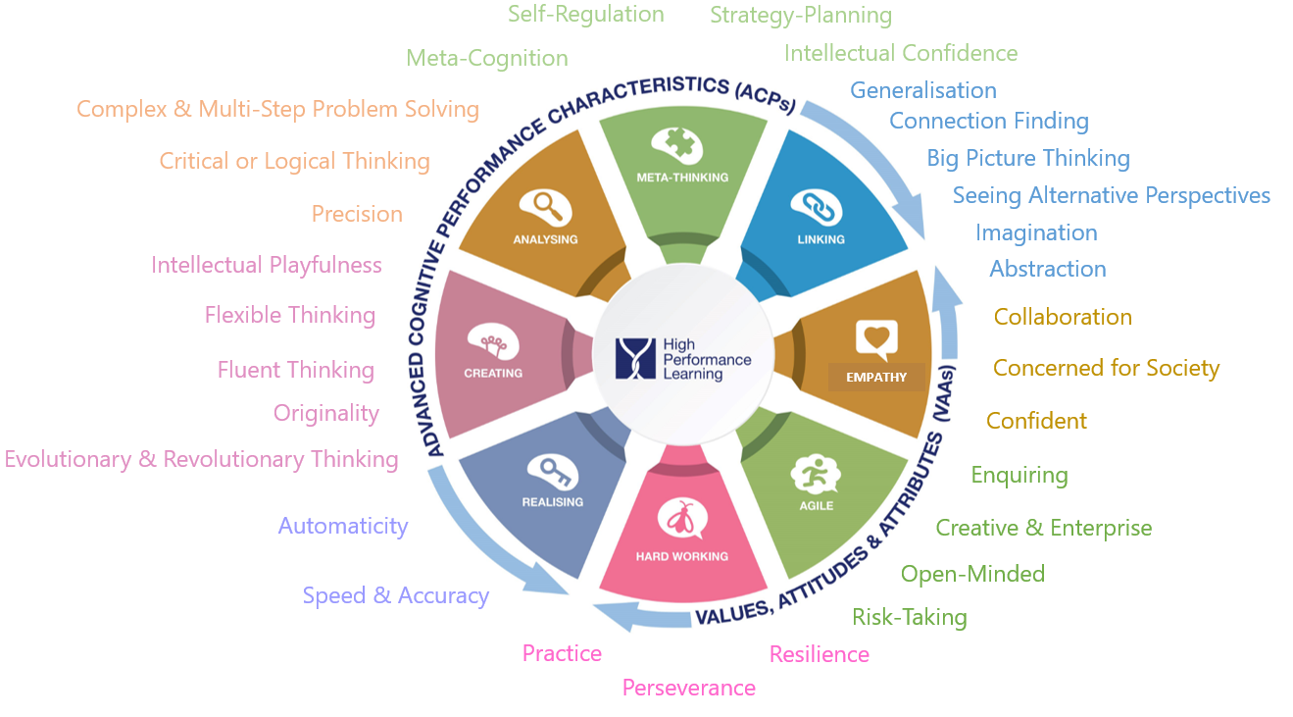
HPL Development
At Caroline Chisholm, we believe that all students are capable of success, and our aim is to provide a high quality education for all our young people.
In 2021 we became a World Class School for High Performance Learning, and joined a fellowship of schools from across the globe. High Performance Learning is at the core of our school’s ethos and is the vehicle to high quality learning and achievement.
We need all staff to be confident in their understanding and articulation of High Performance Learning, and be able to create meaningful learning experiences so all students develop the advanced cognitive performance characteristics, which lead to high performance.
As a new colleague joining the school, or someone who wants to develop their understanding of High Performance Learning, you will be required to evaluate the ACPs and VAAs, and how you are developing them within your teaching and/or role as a form tutor.
There will be short FORMS assessment to complete for each ACP, and a collective one for the VAAs, where you can reflect upon your development of these skills, and highlight areas to focus on moving forward.
Linking Form: https://forms.office.com/e/hBhdzqb1hq
Meta-Thinking Form: https://forms.office.com/e/XrDWYYnsBS
Analysing Form: https://forms.office.com/e/FsMMAn7geY
Creating Form: https://forms.office.com/e/6NJZ7wF8bv
Realising Form: https://forms.office.com/e/8927wp9zfQ
VAA’s Form: https://forms.office.com/e/ZJ4EjymST0
10 Credits
All staff should have a HPL login to access the website and resources. If you do not have one, please speak to Nicola Pinch.

Slide 13
HPL Teacher Pathways
As a World Class School and member of the fellowship and global community for High Performance Learning, we are able to offer a series of qualifications for our staff to demonstrate their expertise and experience in establishing High Performance Learning in their teaching.
There are four levels on the Teacher Pathways scheme, run by HPL.
Several of our colleagues have already successfully complete these courses. Please speak to one of them for more information on their experiences of these courses. We have a limited number of places each year so spaces will be on a application basis.
HPL Teacher
Nahid Akhtar
Emma Poole
HPL Expert
HPL Lead
Miguel Lopez
HPL Assessor
Kat Wittich-Jackson
£500 one-off payment for successful completion
£500 each July for two years for consistency
£1,000 one-off payment for successful completion
£1,000 each July for two years for consistency
£1,500 one-off payment for successful completion
£1,500 each July for two years for consistency
20 Credits

Slide 14
In-House Training
This training format is the one that most of us at CCS will be most familiar with and will continue to form part of our CPD offer.
In-house sessions are those that run after school (outside of team meetings, training days and all through CPD)
We have so much expertise and experience within our school already, and we want to share best practice and support colleagues to be the very best they can be,
These sessions aim to highlight key areas, in line with school priorities, and/or address concerns or gaps that people may have and we want to help fill. For example, an in-house session on how to support visually impaired students in your class.
There are credits for leading these in-house sessions and sharing your expertise, and also for attending them.
10 Credits

Slide 15
NPQ Qualifications
All NPQs are taught through a blended balance of online individual learning and face-to-face meetings. They are designed in recognition that leaders are already busy people, with a new, simplified end-of-course assessment.
There are two cohorts annually, starting in November and February.
Four NPQs in specialist areas of teaching have been designed with both classroom teachers and leaders in mind. They are:
Leading teacher development – learn how to become a teacher educator and successfully support teachers in your school to expand their skills
Leading teaching – learn how to lead the teaching and learning of a subject, year group or phase
Leading behaviour and culture – learn how to create a culture of good behaviour and high expectations in which staff and pupils can thrive
Leading literacy – learn how to effectively teach and promote literacy across the whole school, year group, key stage or phase
The leadership NPQs are:
Senior leadership – develop your leadership knowledge and expertise to improve outcomes for teachers and pupils in your school
Headship – develop the knowledge that underpins expert school leadership and apply it to become an outstanding headteacher
Executive leadership – develop the expertise you need to become an outstanding executive leader, leading change and improvement across your group of schools or multi-academy trust
Early years leadership – develop expertise in leading high-quality early years education and care, as well as effective staff and organisational management
Each NPQ is underpinned by a new content framework. These frameworks set out what participants should know and be able to do after completing an NPQ. Providers have used these to design their courses.
As well as the reformed NPQs, an early headship coaching offer is available for new headteachers. This is a package of structured support and networking opportunities for teachers early on in their headship role.
40 Credits

Slide 16
Reading
At CCS we value reading and the learning that can come from delving into a good book!
We have chosen several books for 2023/2024 that we feel cover a range of educational topics.
If you choose to read one of these books as part of your CPD journey, we ask that upon completion, you submit approximately 300 words on the book, and what you have taken from it that could enhance your practice.
Bates – Fix the System, Not the Women
Bethune & Kell – A Little Guide for Teachers: Teacher Wellbeing and Self-Care
Bomber – Know Me to Teach Me
Bomber – Inside I Am Hurting
Bomber – What about me?
Cowley – The Ultimate Guide to Differentiation
Dix – When Adults Change, Everything Changes
Eyre – High Performance Learning: How to become a World Class School
Geddes – Attachment in the classroom
Hollins – 30 Thinking Tools that Separate the Average from the Exceptional
Kara – Diverse Educators: A Manifesto
Kellerman – Professionalised Leadership
Muhammad – Transforming School Culture
Myatt – High Challenge, Low Threat
Myatt – The Curriculum – Gallimaufry to Coherence
Perry – Teenagers and Attachment
Pinkett – Boys Don’t Try? Rethinking Masculinity in Schools
Robbins – Middle Leadership Mastery: A Toolkit for Subject and Pastoral Leaders
Silver – Attachment in Common Sense and Doodles
Sinek – Leaders Eat Last
Whitehouse and Pudney – Volcano in my tummy
Willingham – Why Don’t Students Like School? A Cognitive Scientist Answers Questions
10 Credits

Slide 17
Technology and Innovation – Microsoft Learn
https://learn.microsoft.com/en-us/training/
Our digital strategy is unique and we want to ensure our staff are up to speed with digital technologies, and how to maximise their effectiveness to support learning.
Microsoft learn have a wide range of courses to educate you on how to use a variety of platforms we come across daily. These platforms can support teaching and learning and it is important that all staff are up to date on how to use these effectively.
We have two options, and need you to select one of the two options to contribute towards your credits.

Slide 18
Technology and Innovation – Microsoft Learn
Option 1 (10 credits)
Choose two courses from the following list. All courses are designed to take 1 hour, but in practice take less time.
NB If you find another course that lasts 1 hour that you would like to undertake instead, then that is fine as long as it is still based around technology. Please let Anne Louise Whitehead know if this is the case.
1 Get started with OneNote Get started with OneNote - Training | Microsoft Learn
2 Structure Teams through channels, tabs, files, and apps
Structure Teams through channels, tabs, files, and apps - Training | Microsoft Learn
3 Assign and assess learners with assignments and forms Create authentic assessments with Microsoft Forms - Training | Microsoft Learn
4 Converse, collaborate, and build community in Teams Converse, collaborate, and build community in Teams - Training | Microsoft Learn
5 Hybrid learning: A new model for the future of Learning Hybrid learning: A new model for the future of learning - Training | Microsoft Learn
6 Staying connected with remote learning through Microsoft Teams and Office 365 Stay connected with remote learning through Microsoft Teams and Microsoft 365 - Training | Microsoft Learn
7 OneNote Class Notebook: A teacher's all-in-one notebook for students OneNote Class Notebook: A teacher's all-in-one notebook for students - Training | Microsoft Learn
Option 2 (10 credits)
(This option is instead of, not as well as, Option 1)
Undertake either one of the longer courses listed below on the Microsoft Learn Platform. These have a number of sections (some of which appear in option 1) and together give a wider range of training.
1 Master Microsoft Teams for any learning environment. Microsoft Teams makes teaching and learning easier with all your content, apps, and tools always there, in one place, designed to help teachers and students get the most out each day.
This training will help you master Teams. Master Microsoft Teams for any learning environment - Training | Microsoft Learn
2 Microsoft Educator Academy Microsoft Educator academy - Training | Microsoft Learn
This is a path focused on best practice and some basics for facilitating a blended or hybrid learning environment.
Once you have successfully completed your course(s) please send a screen shot of your completion confirmation to Anne Louise Whitehead so she can log it on your CPD file
10 Credits

Slide 19
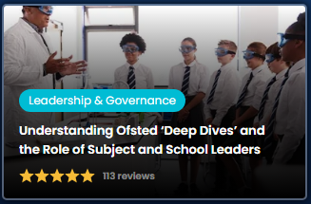
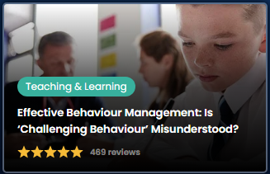
The National College
With over 2500+ courses, webinars & resources for all staff, The National College has something for everyone.
These are usually fairly short (up to 1 hour) courses that are tailored to specific training needs and built for a range of areas and roles:
Education | Role | Type
Leadership & Governance Teaching and Learning Health & Safety Online Safety Mental Health SEND Climate Education | Leaders Teachers and Practitioners Teaching Assistants Support Staff Governors & Trustees | Webinars Guides Courses Lesson Plans Policy Templates
All staff must complete two courses – of their choice. Upon completion, please send a copy of your certificate to Anne Louise Whitehead
10 Credits

Slide 20
Research – Coming in 2024
Cultivating a research-based approach to developing your practice provides evidence to effect change in your teaching, your classroom, your school, and beyond.
Research can:
Help you find solutions to particular problems arising in your classroom or school
Underpin professional learning of knowledge, skills and understanding
Connect you with sources of information and networks of professional support
Clarify purposes, processes and priorities when introducing change – for example, to curriculum, pedagogy or assessment 5. Improve understanding of your professional and policy context, organisationally, locally and nationally, enabling you to teach and lead more
strategically and effectively
Develop your influence, self-efficacy and voice within your own school and more widely within the profession.
Research as part of your CPD
First steps:
Decide on an area of interest to you, perhaps an area that you want to develop further in, or where you see a gap.
Prepare a research proposal to share with the leadership team – this is an application only CPD pathway
If successful:
Conduct a thorough investigation into the latest research and best practice available
Summarise your findings in a ‘Summary of Professional Thinking’ of 2,000 words (give or take 10%) and present this to the leadership team by the end of term 2
In terms 3-4 you will be expected to trial some new ideas with small groups or staff or students, and record the impact
In term 5 you should consider how the whole school community can act upon your research
If your trial demonstrates that implementing your research could have a positive impact on students and the wider school, you would be invited to implement on a larger scale.
TBC
Credits

Slide 21
Support and Remuneration
You would become part of a CCS Research Team, supporting each other throughout the year
Time to visit other schools to conduct research (liaise with Mandy Atkins)
The total remuneration for this post is £750 for the academic year
This will be paid in 3 x instalments. £100 at the end of term 2, £150 at the end of term 4, and £500 at the end of term 6 – on successful submission of the work outlined.
How to apply for the role:
Contact Kat Wittich-Jackson if you would like an informal chat about your idea.
To apply formally, please email Anne Louise Whitehead With a formal expression of interest and attach two or three PPT slides (max) for a presentation answering the following points:
What is your research idea and why is it of interest?
Any work you have already undertaken in this area (not essential)
Why this is important to our context at CCS
If called for interview you will be expected to explain on these ideas and be prepared to answer questions about your proposal.

Slide 22
Credits
Credits for teaching staff are rewarded for CPD undertaken from 1st September, for support staff 1st April each year
The deadline for Silver, Gold and Platinum will be 20th July for teaching staff, and 28th March for support staff
For CPD Bronze level, the deadline will be 31st August for teaching staff and 28th March for support staff
We want to encourage everyone to choose from a range of CPD options, so that your experience over the year is varied and meaningful. Some of the options are essential (e.g. Microsoft Learn) and then individuals can choose the other routes for their continued professional development. We hope that this enables staff to develop in their own way, in areas and on pathways that interest them, whilst also benefitting our young people and supporting our school priorities
Training | T | S | Essential | Credits | Guidance
Cadet Training |  |  |  | 10 per course (up to 30 credits) | Please speak to Iain Rayner for more information
ECT Training |  |  |  (if you are an ECT) | 40 credits Year 1 20 credits Year 2 | Successful completion of Brightspace modules & 60%+ attendance at twilight sessions with JKI
External Courses |  |  |  | 10 Credits per course | For external courses that last more than one day – please see KW regarding credits (NPQs and HPLs are already listed)
First Aid Training |  |  |  | 30 Credits (training year) (20 Credits thereafter) | Must be part of the whole-school first aid rota
HPL Development (student facing staff) |  |  | (if a new teaching colleague) | 10 Credits | Open to all colleagues, but essential for those who joined the school from July 2023
HPL Teacher Pathways (Year 1 of CPD programme – HPL lead applications only) |  |  |  | 20 Credits | Leads must support those on the HPL Teacher course. Plus financial renumeration.
Leading Training for other staff |  |  |  | 10 Credits per session (up to 30 credits)
Mentoring (for ITT/ECT or new colleague in team) |  |  |  | 10-20 Credits | Please liaise with Kat or Annie for confirmed credits
Microsoft Learn – Option 1 OR Option 2 |  |  |  | 10 credits | Note, two courses must be completed for option 1 to gain the 10 credits
National College Courses |  |  |  (not for ECT Yr1) | 10 Credits per session (up to 30 credits) | Two courses must be completed to gain the 10 credits
NPQ – leadership (18 months) |  |  |  | 40 Credits per year | Must share knowledge from course, leading sessions to support development of colleagues
NPQ – specialist area (12 months) |  |  |  | 40 Credits | Must share knowledge from course, leading sessions to support development of colleagues
Reading |  |  |  | 10 Credits per book (up to 30 credits)
Researcher Role – coming soon: Sept 2024 |  |  |  | TBC | Plus financial renumeration – application only
In-House Training |  |  |  | 10 Credits per session (up to 30 credits)

