Slide 1
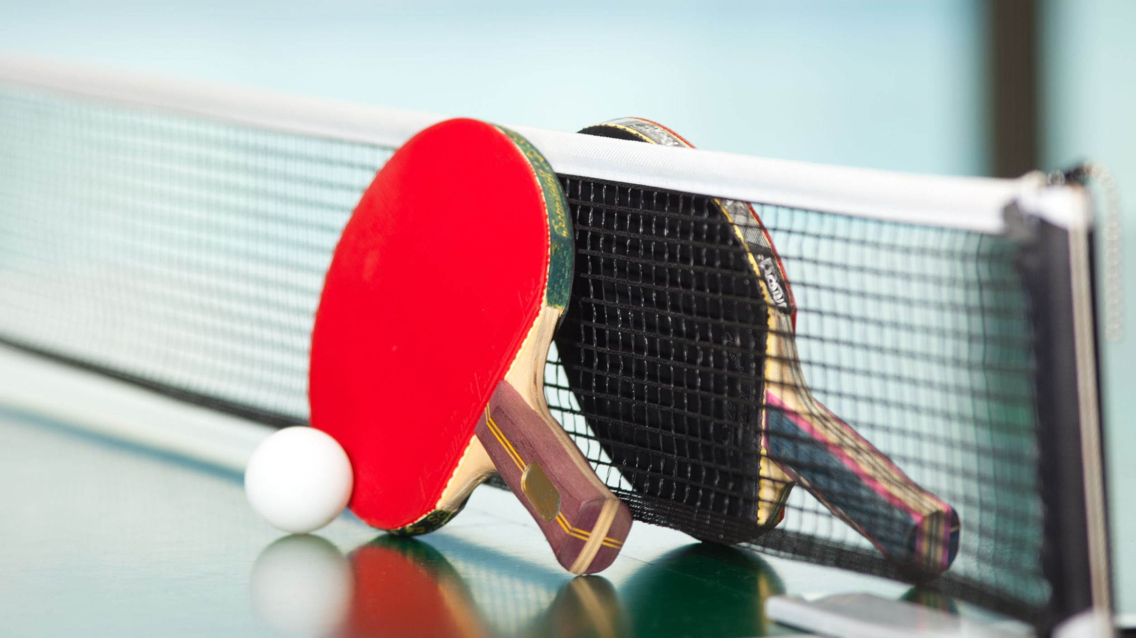
Year 7 Design Technology
Table tennis bat project

Slide 2


What are you going to learn?
You are going to learn about woods and manufactured boards
You are going to learn how to design CREATIVELY
You are going to learn how to use a variety of tools and equipment
You are going to learn how to make a QUALITY product

Slide 3
Brief
You must design and make a table tennis bat to be used by 11 – 14 year olds
The table tennis bat will be made from plywood, pine and foam

Slide 4

What is a specification?
Look at the picture on your table
What might the designer’s specification have looked like?
Discuss in your group what specification points might have been given to the designer
HPL focus - ANALYSING

Slide 5
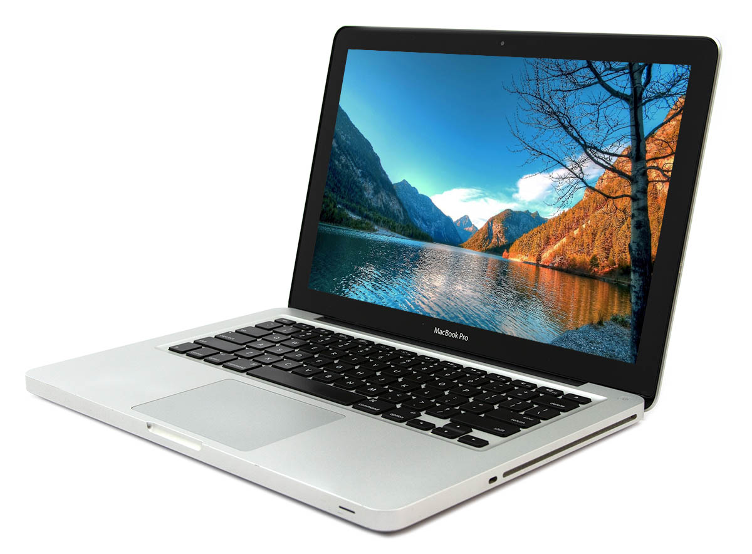
What would the design specification for this product be?

Slide 6
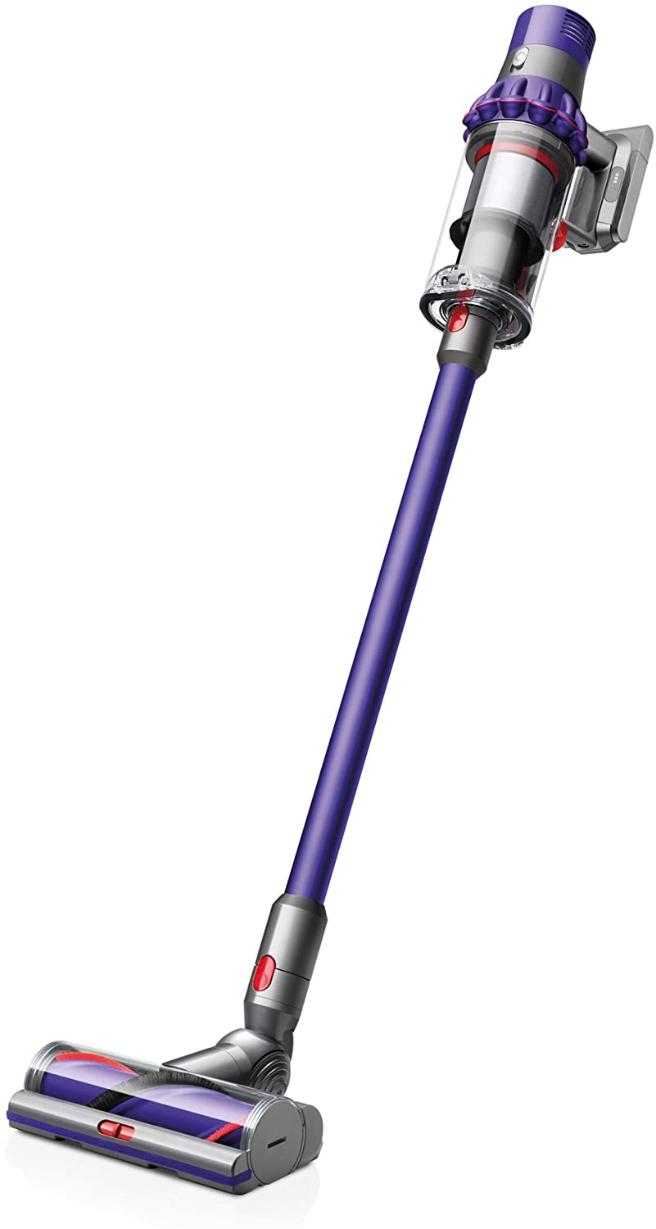
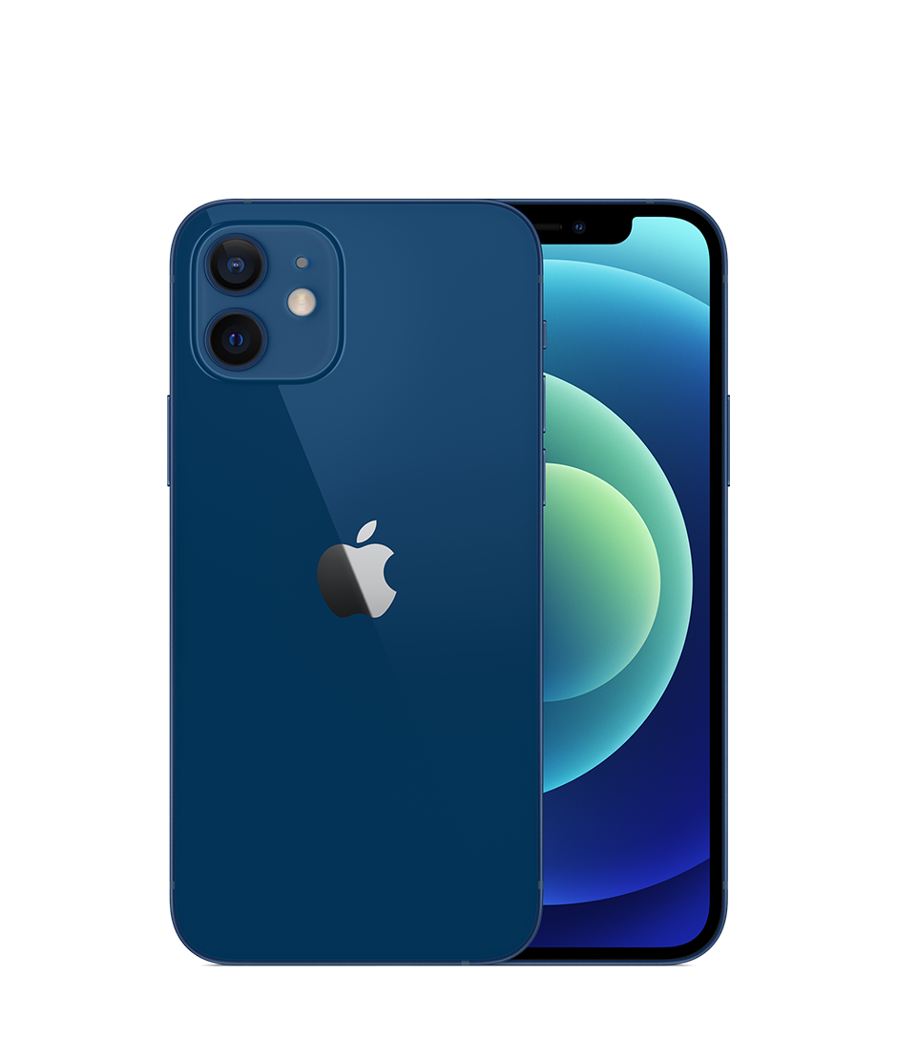
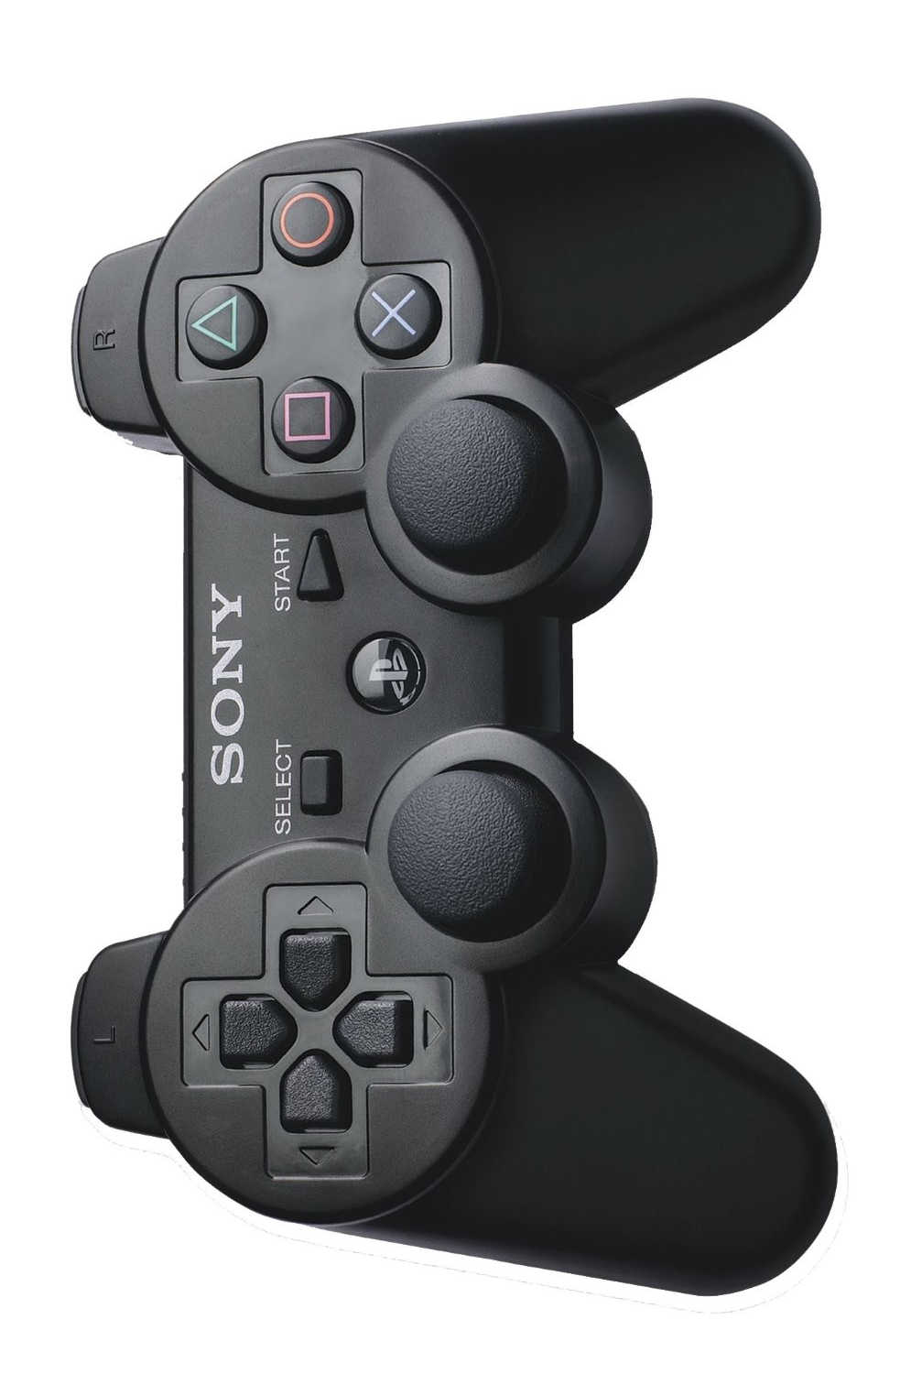
ANALYSING
Critical thinking
Notes:
Print x1

Slide 7
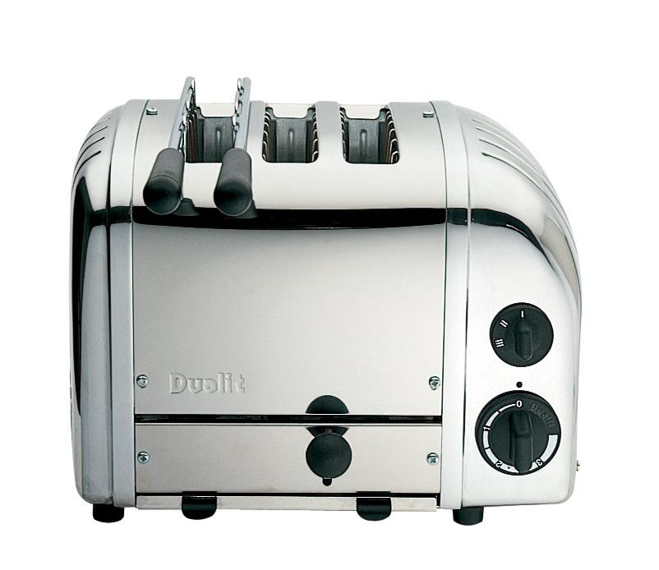
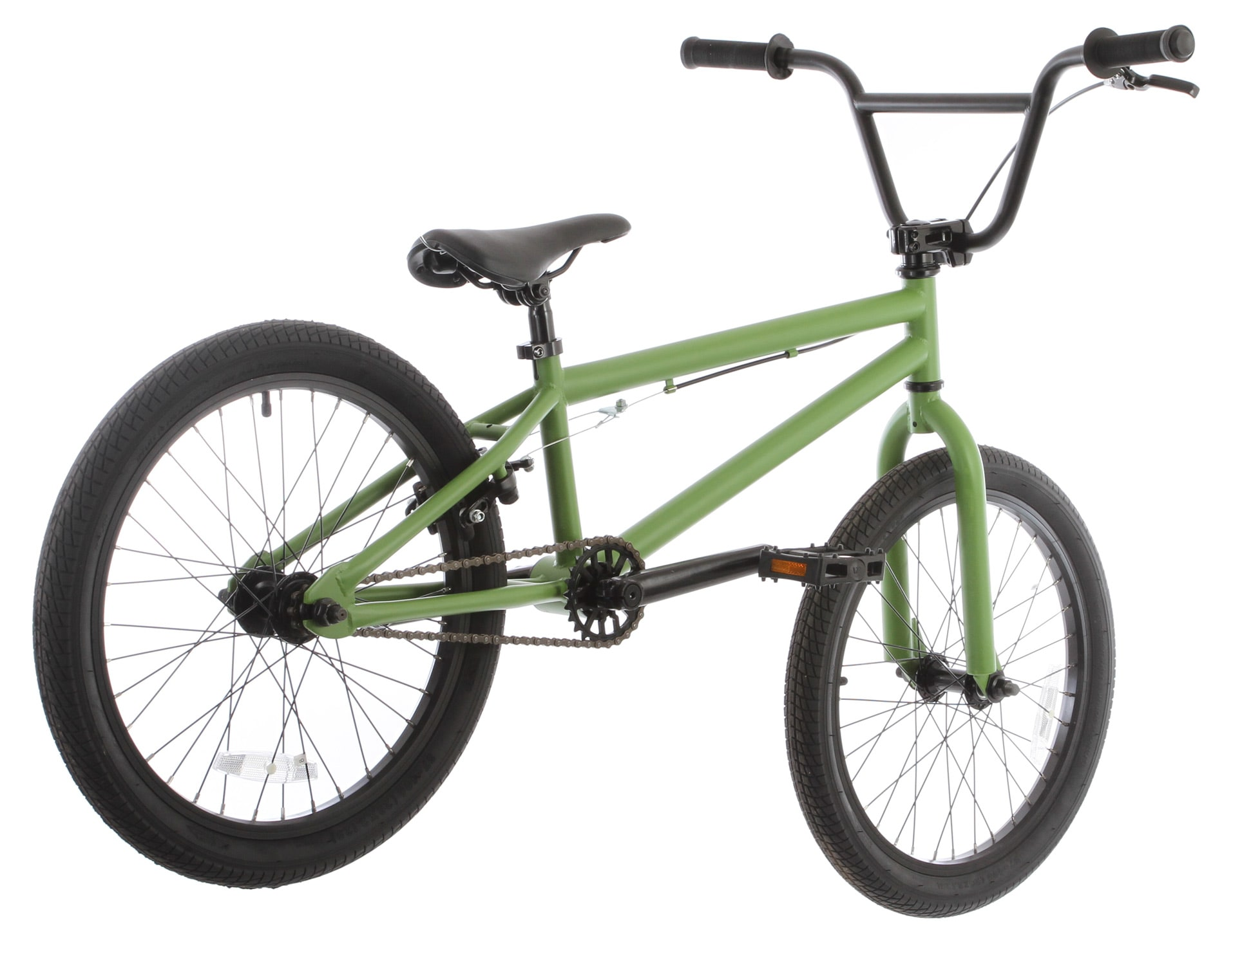
ANALYSING
Critical thinking
Notes:
Print x1

Slide 8
Specification
Specification | Justification
The bat must have an ERGONOMICALLY shaped handle | So that it is comfortable to use
The bat must have smooth edges | So that it is safe to use
The paddle must have an interesting and colourful design on both sides | To make it stand out and appeal to the user
?
?

Slide 9
Orthographic drawing
This drawing shows the important DIMENSIONS of the bat
It is vital that you adhere to these measurements as closely as possible
All dimensions are in millimetres (mm)
HPL focus - ANALYSING

Slide 10
Practical assessment

Slide 11

Accuracy
Template
Why do we use templates?
Easier
Every one the same
Faster
Repeatable
(can be done many times)
Less likely to make mistakes
HPL focus - REALISING

Slide 12
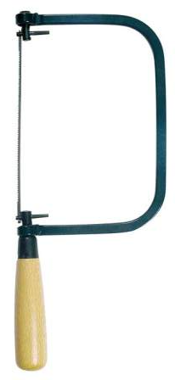
Using a coping saw – Risk assessment
Hazard | Control measure
You can cut your fingers | Always make sure you are not cutting towards your hand Ask teacher to replace broken blades
You could cut somebody else | Don’t carry tools around the workshop Be aware of your surroundings Only 4 students to a table
Cutting can create dust | The room is large and well ventilated You must wear an apron
You can pinch your fingers in a vice | Use vices correctly – don’t ‘drop’ the handle
You can get splinters from the materials you are cutting | Handle materials carefully, particularly when moving around the vice

Slide 13
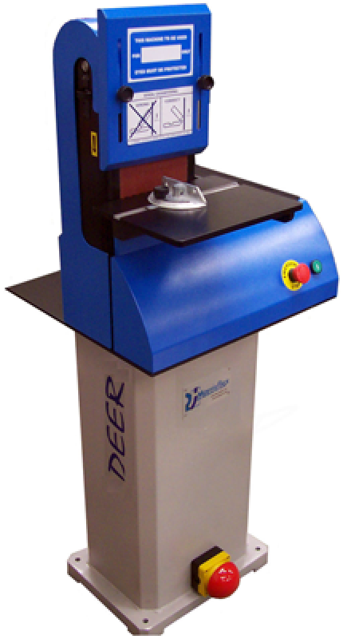
Using a band facer – Risk assessment
Hazard | Control measure
You can graze/cut your fingers | Always make sure your hands are away from the band Be aware of emergency stop procedure
You could cause harm to somebody else | Don’t carry tools around the workshop Be aware of your surroundings Only one person on the band facer At least 1 metre of space behind you when working
Sanding can create a lot of dust | The room is large and well ventilated You must wear an apron You must make sure dust extraction in on
Your eyes could be injured by flying particles | Always wear safety goggles
Hair and clothes can be caught in the machine | Always wear an apron Long hair must be tied back

Slide 14
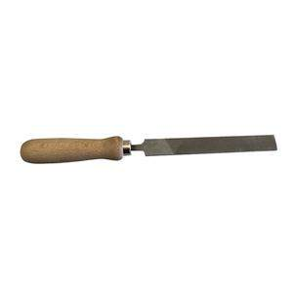
Using a file – Risk assessment
Hazard | Control measure
You can graze/cut your fingers | Always make sure you hold the file securely Do not have your hand IN FRONT of the file when working
You could cause harm to somebody else | Don’t carry tools around the workshop Be aware of your surroundings Only one person to each vice At least 1 metre of space behind you when working
Filing can create a lot of dust | The room is large and well ventilated You must wear an apron You must not blow dust away from your work
The handle can become loose and fall off, leaving a sharp point | Always make sure handle is secure Tell the teacher if you drop the file

Slide 15
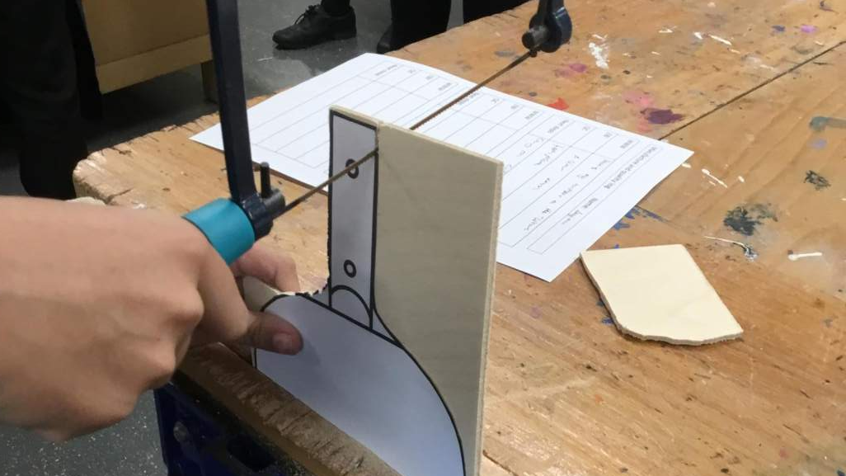
What is this student doing wrong?
HPL focus - ANALYSING

Slide 16
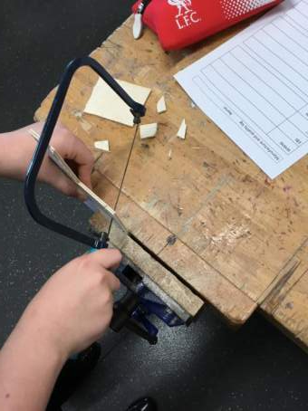
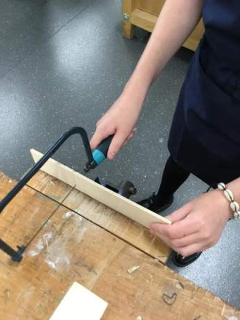
Cut edge

Slide 17

What a good one looks like…
After cutting
After filing and sanding
Notice how neat the cut is and how smooth the edges are
How does yours compare to this one? What do you need to do better next time?
Use the QUALITY table to evaluate your work!
WWW
EBI
QC
Next steps
HPL focus - ANALYSING

Slide 18

Making the handle
CHAMFER
How do you think we could make the handle?
What tools could be used to shape it?
How could we make the holes for the dowels?
How can we fix the handle to the paddle?
DOWELS
PINE handle
HPL focus – META-THINKING

Slide 19
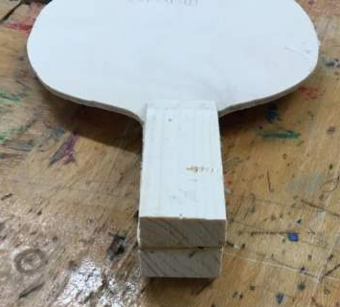
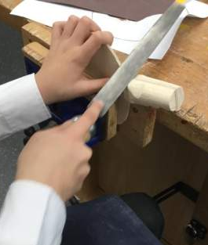
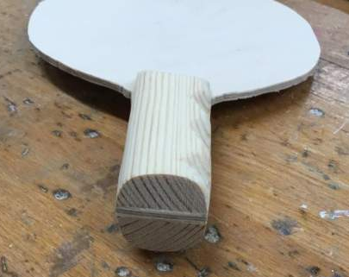

Making the handle – Ergonomic shaping
EXTENSION
HPL focus - CREATING
HPL focus - REALISING
Flexible thinking
Accuracy

Slide 20
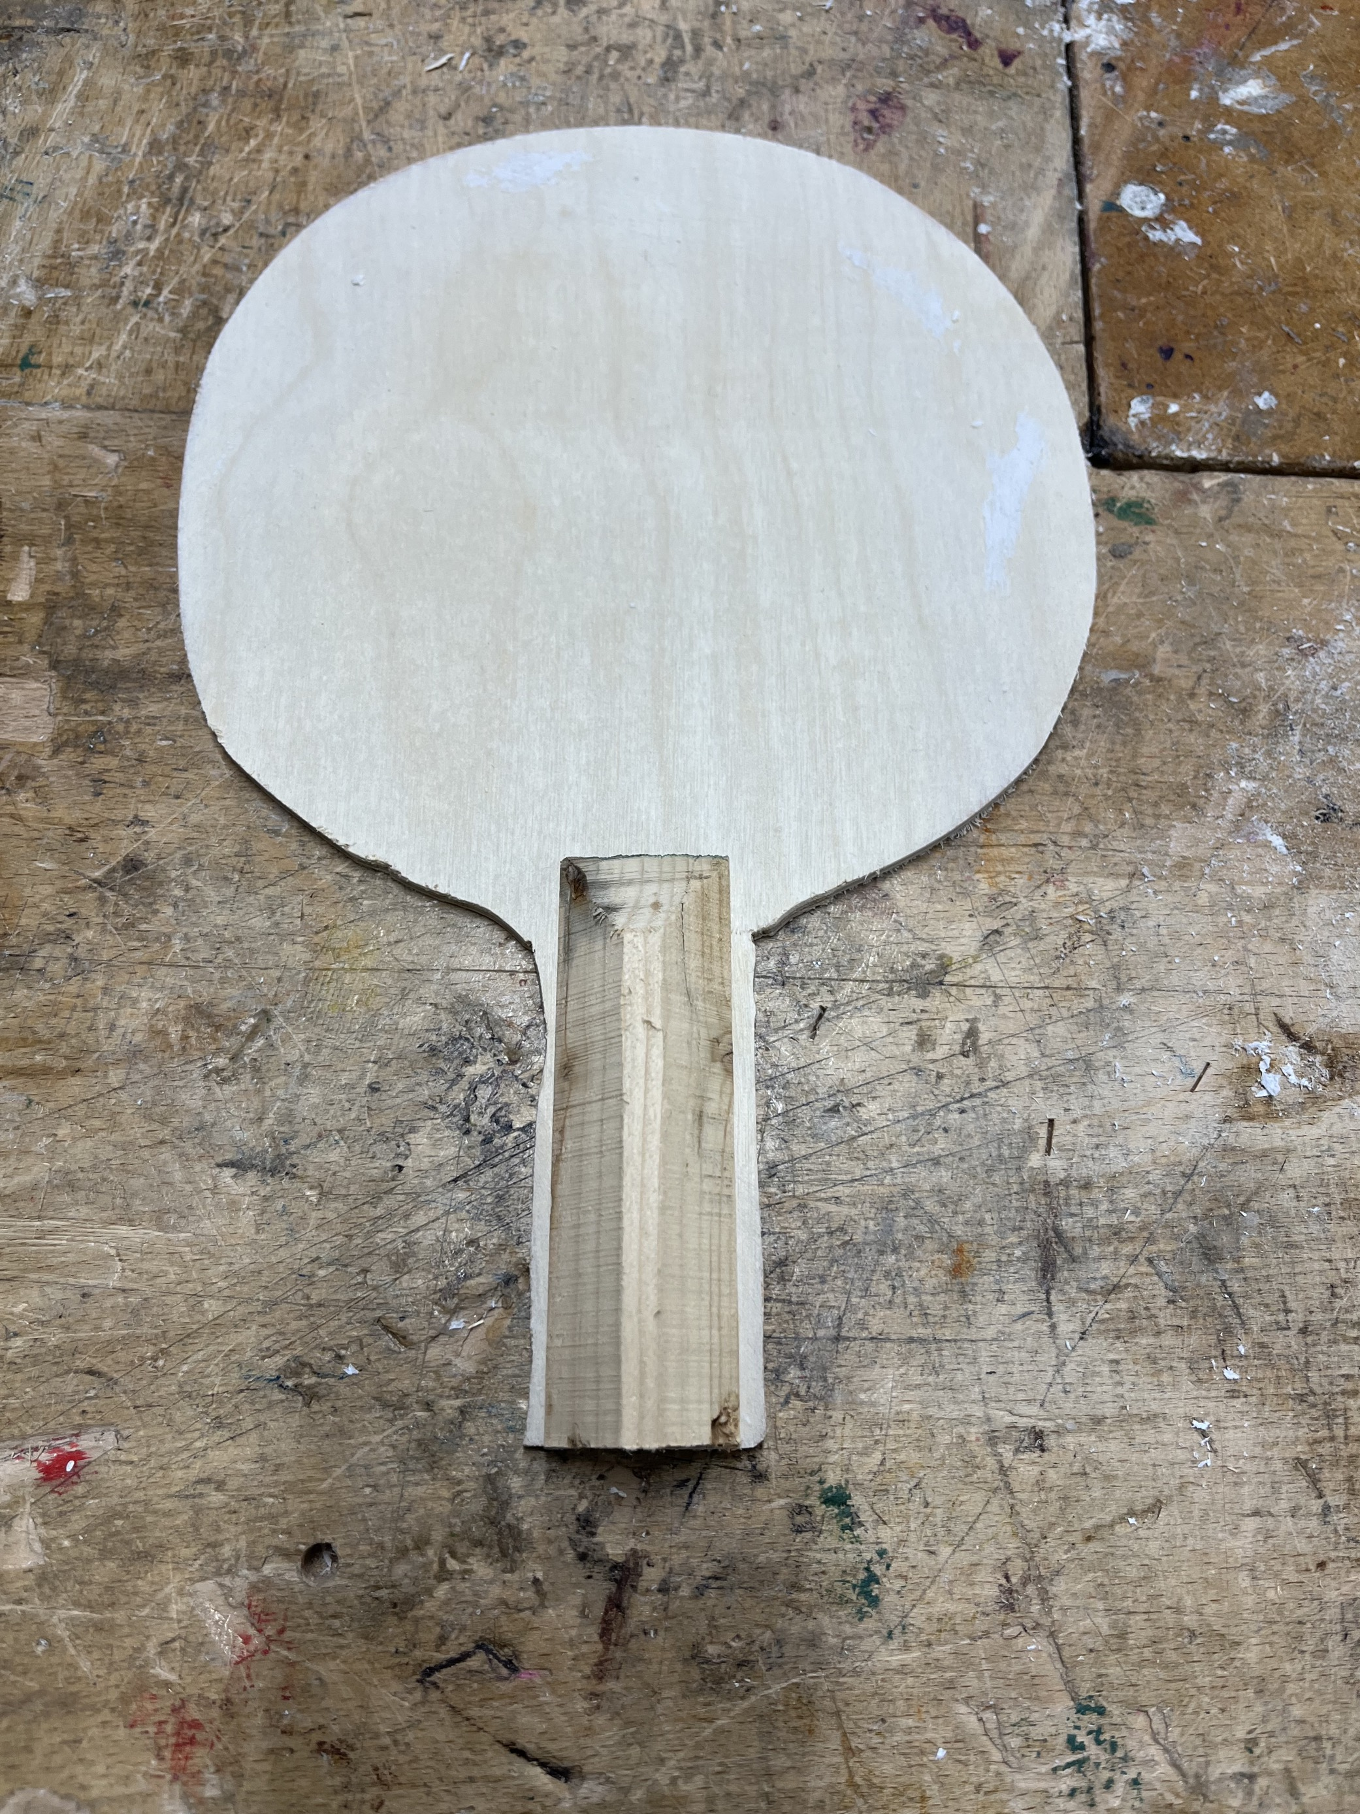
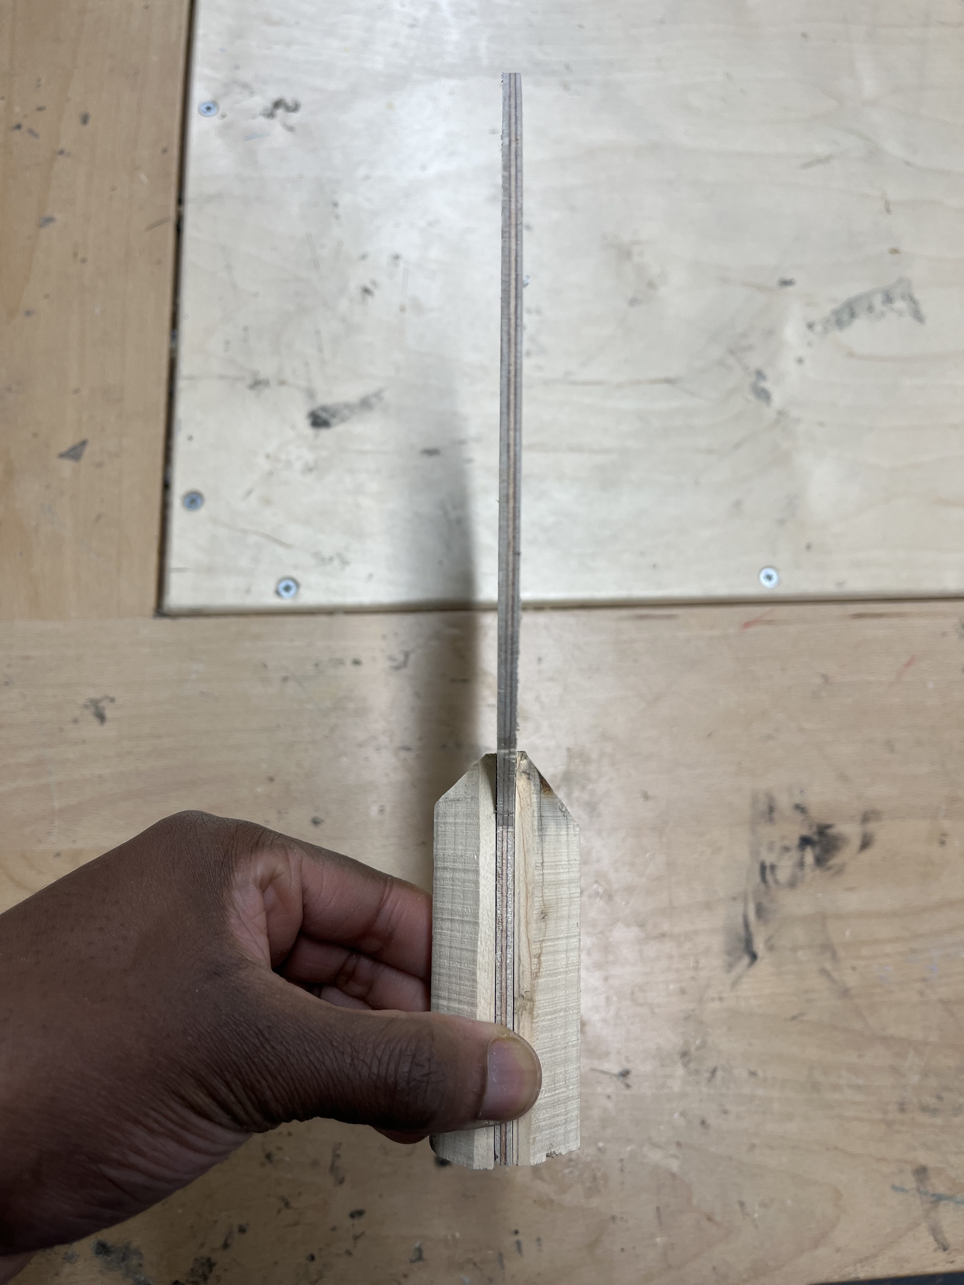
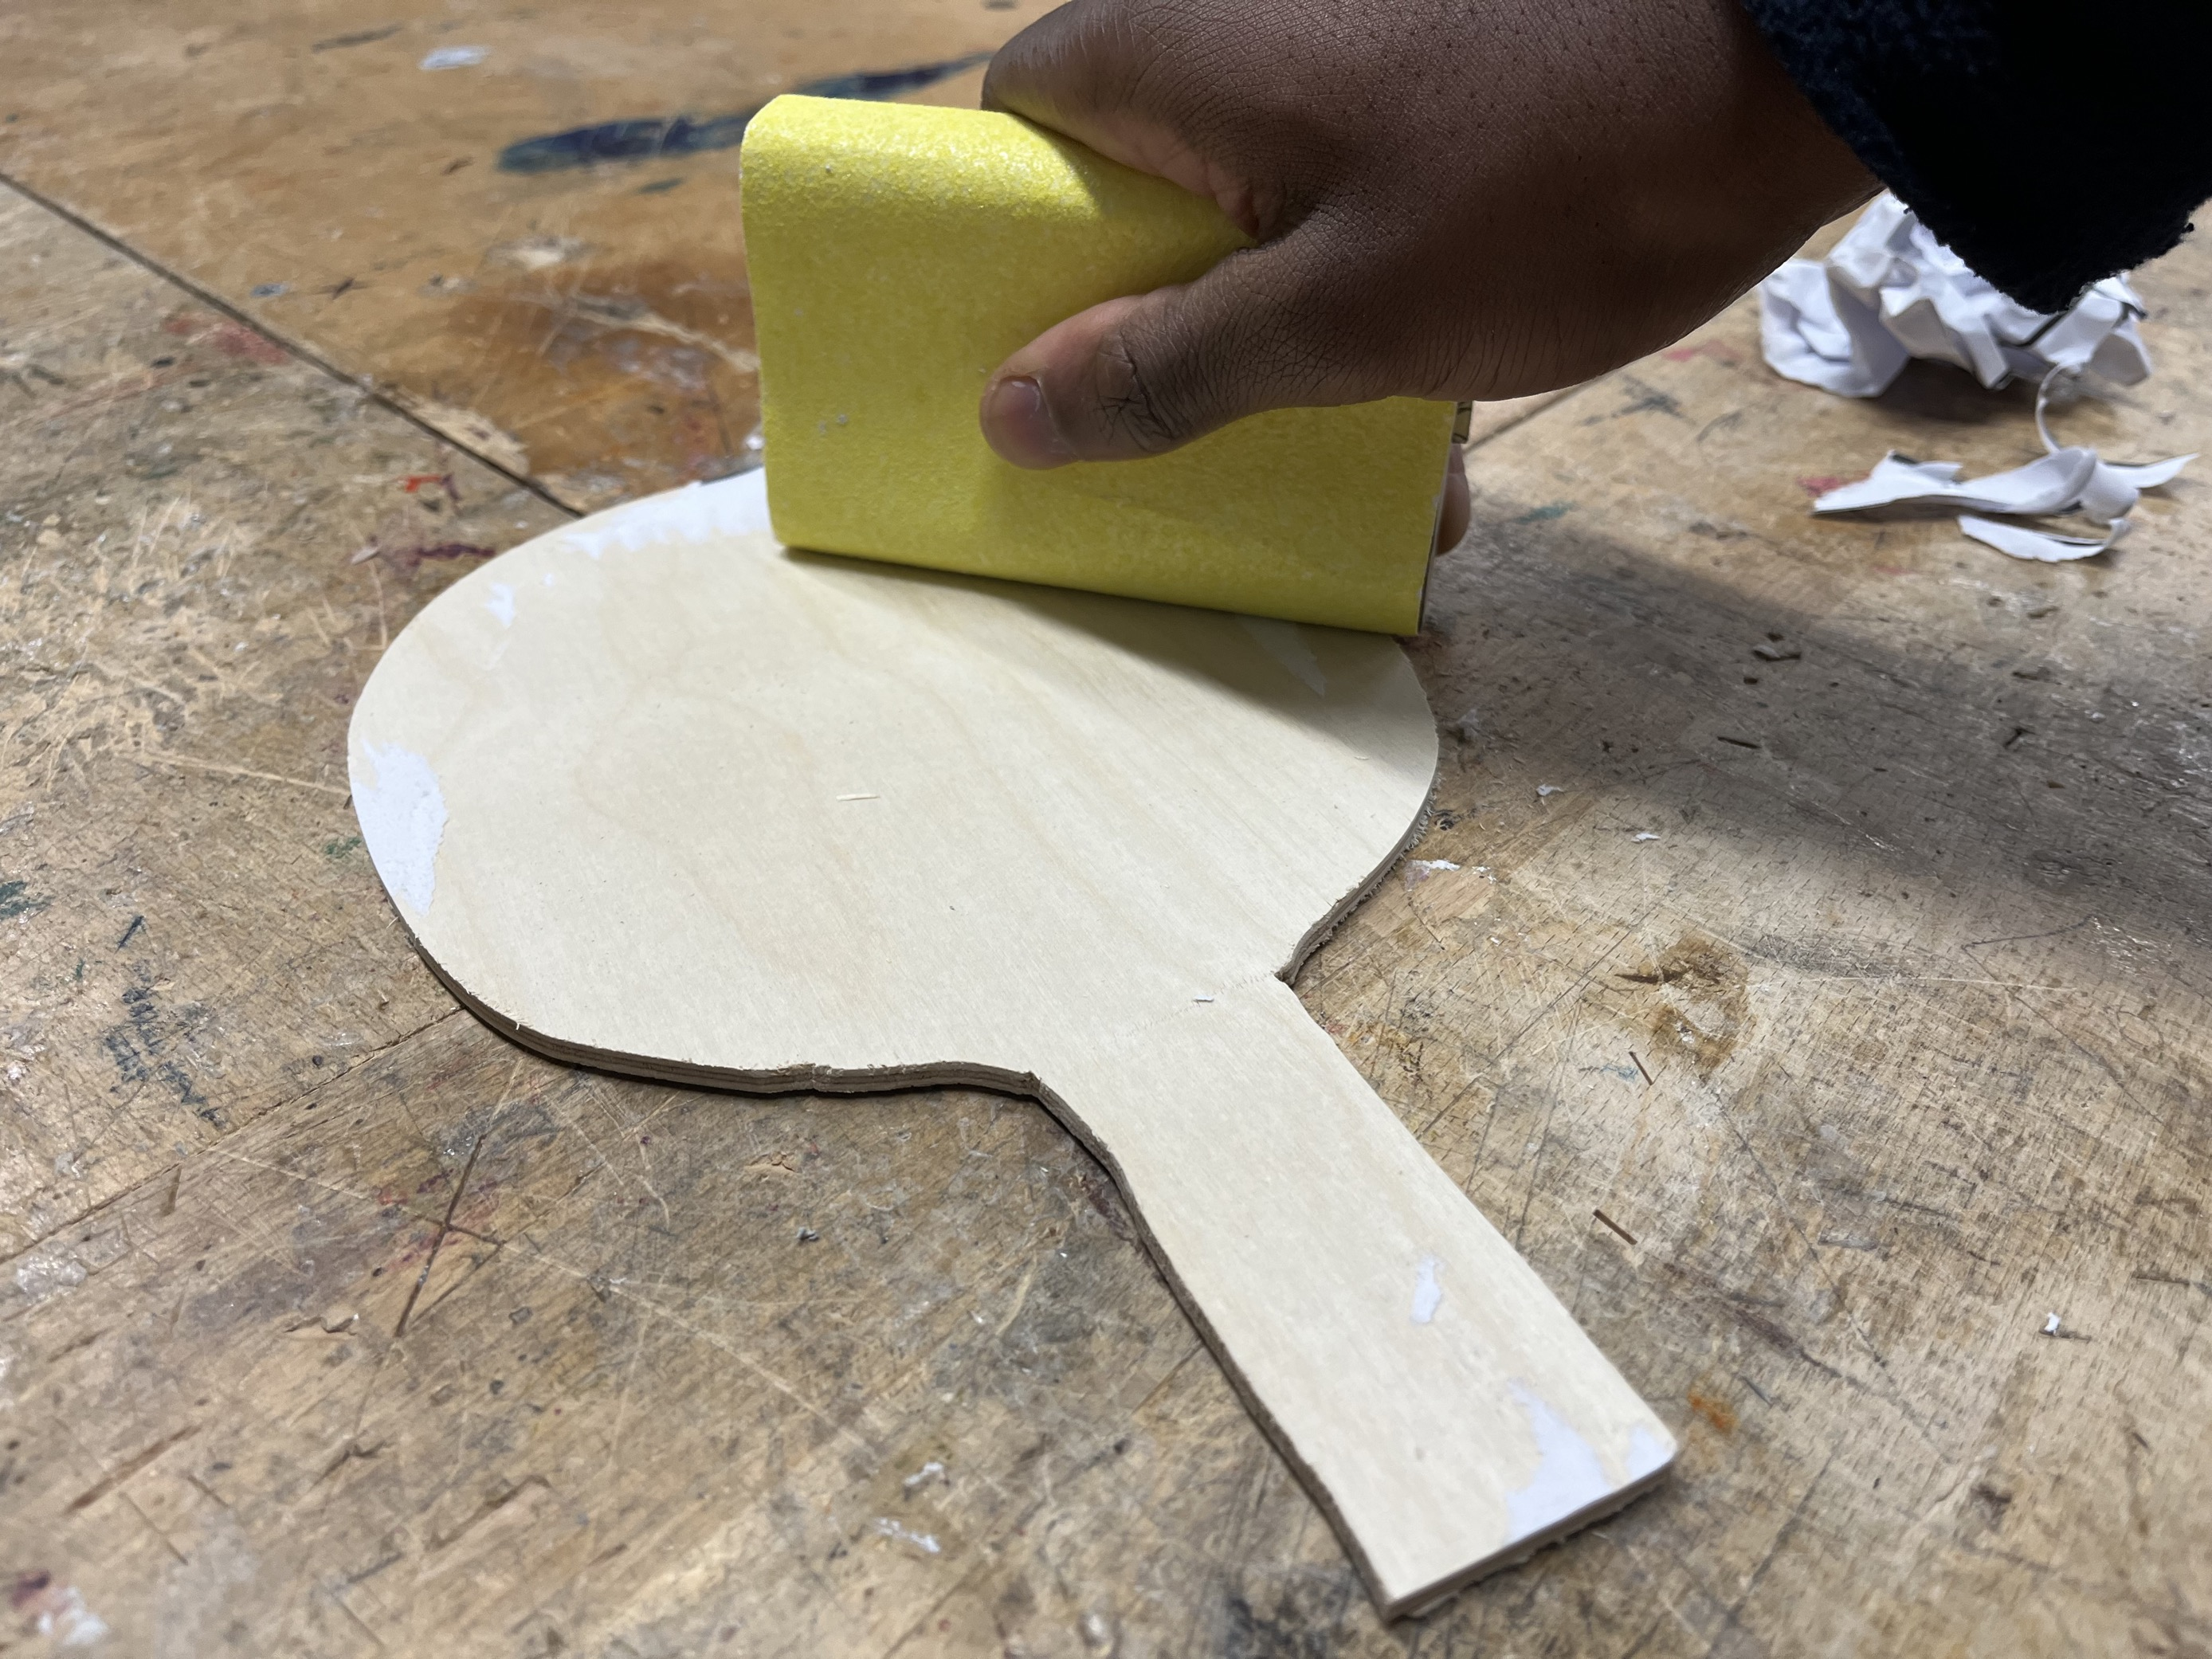
Attaching the handles
End result.
Why do you think I am holding the sanding block this way?
HPL: Analysing.
Step 1: Remove the paper template from the bat. You will have to use a sanding block to remove any stubborn bits.
Step 2: When all the paper is removed, you will have to use PVA glue to attach handle.
Make sure the chamfered edge is upright.
Step 3: Glue the second part of the handle onto the other side of the bat.

Slide 21
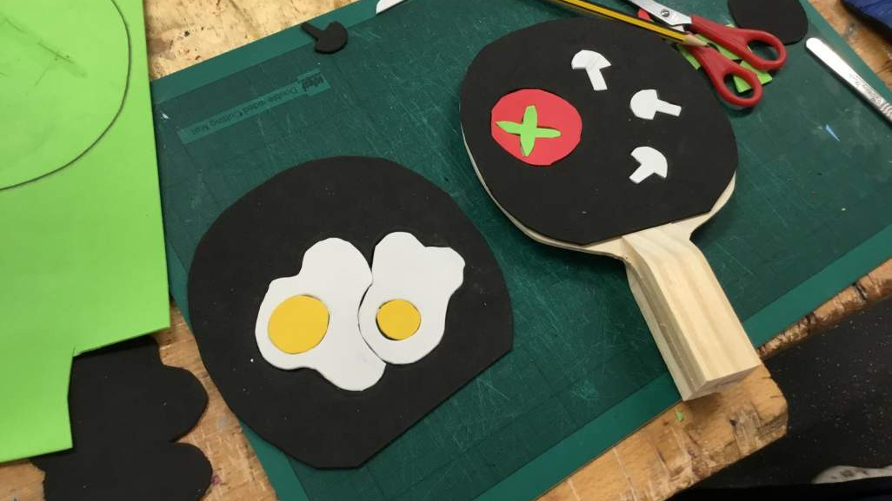
Designing your paddle
HPL focus - CREATING

Slide 22

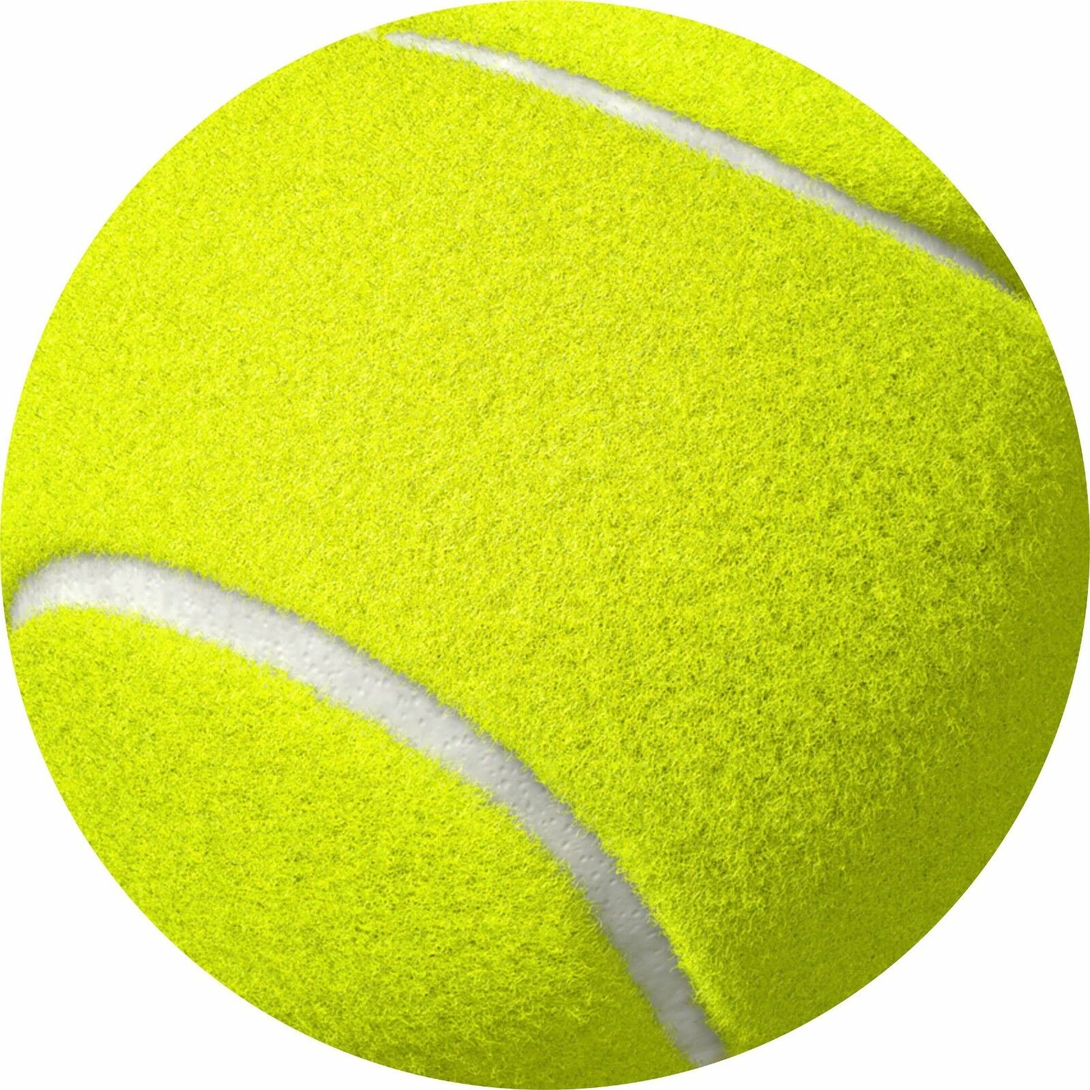

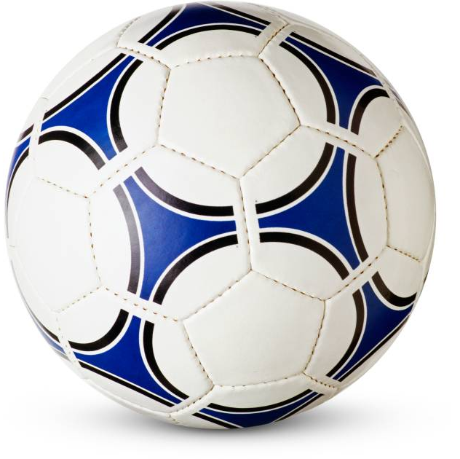
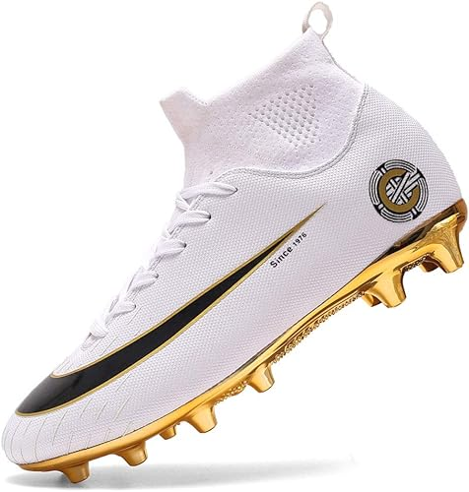


Starter: Create a moodboard of images for design inspiration on ONE slide.
Analysing & Linking
REMEMBER, Your bat has two sides. So the imagery that collect, think about how the images can work in pairs.

Slide 23
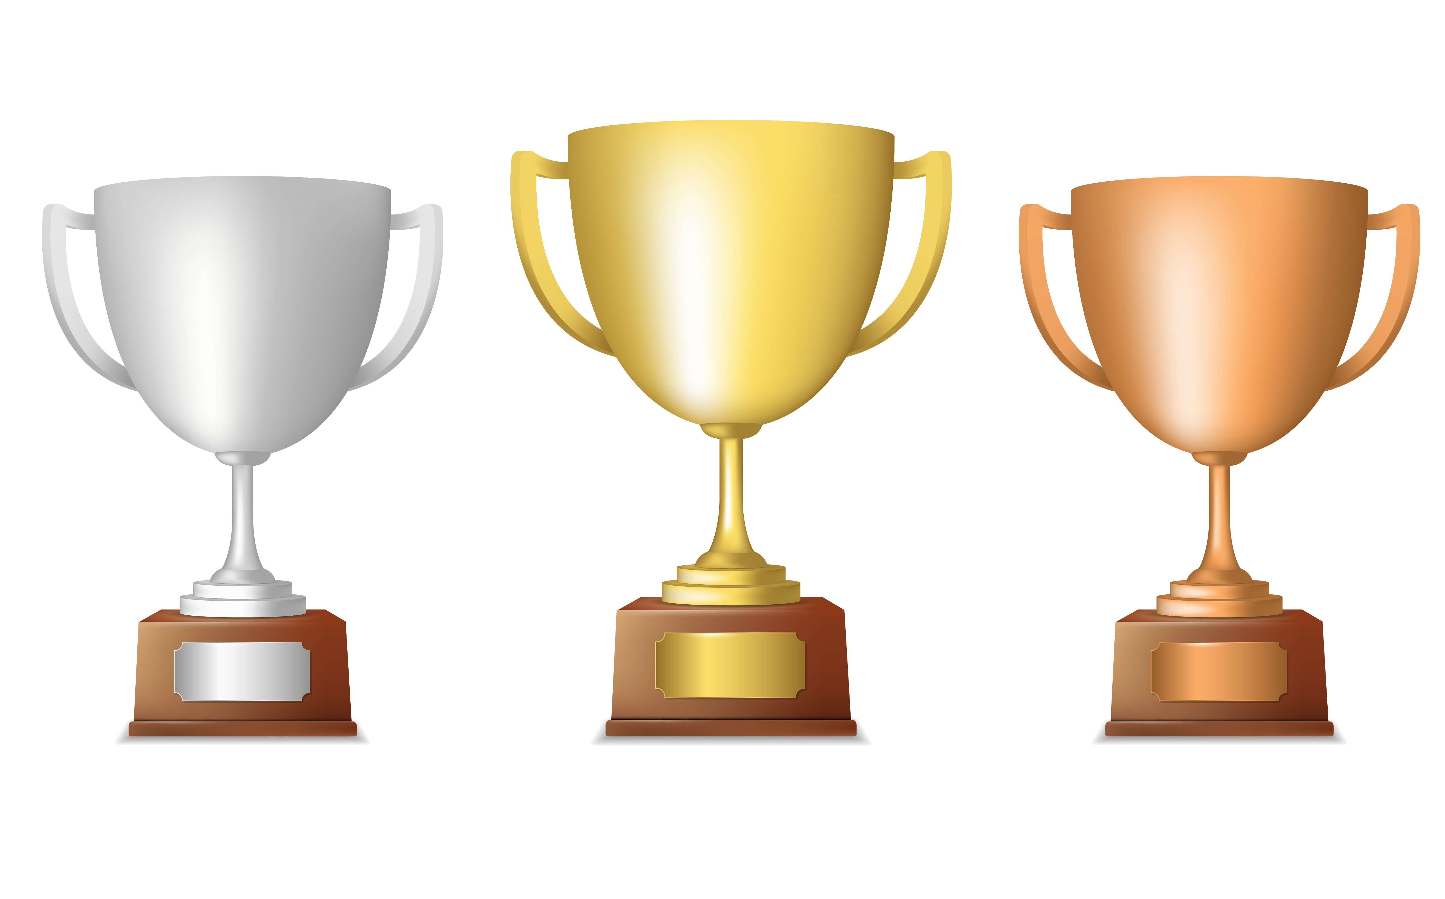
 |  | Subject knowledge | HPL
 | 9 | Large range of design ideas High level of detail and quality of communication Detailed explanation of benefits and limitations of ideas | Fluent thinking - creating lots of design ideas quickly Flexible thinking – showing that you can modify or drop ideas all together if you don’t think they’ll work Originality – can you come up with something new and unique?
 | 8
 | 7
 | 6 | Good range of design ideas Appropriate level of relevant detail and clear communication techniques Explanation of benefits and limitations of ideas is relevant
 | 5
 | 4
 | 3 | Small range of basic ideas Little or no explanation of materials or benefits and limitations of ideas
 | 2
 | 1
CREATING
Design assessment
Design assessment

Slide 24
This an opportunity for you to customize the design of your paddle and really make it personal to you!
You will:
Use inspiration to design each side of the paddle
Use the design template to ensure your design is DRAWN TO SCALE
Cut foam using scissors and a scalpel
Assemble using spray mount
X2
HPL focus - CREATING
Flexible thinking (you need to adapt your design to make it feasible to make from neoprene)
Originality (can you come up with something that is completely new and unique?)

Slide 25


Your table tennis bat has 2 sides so you will need to CREATE 2 different designs
How could we ensure we get a good quality outcome?

Slide 26
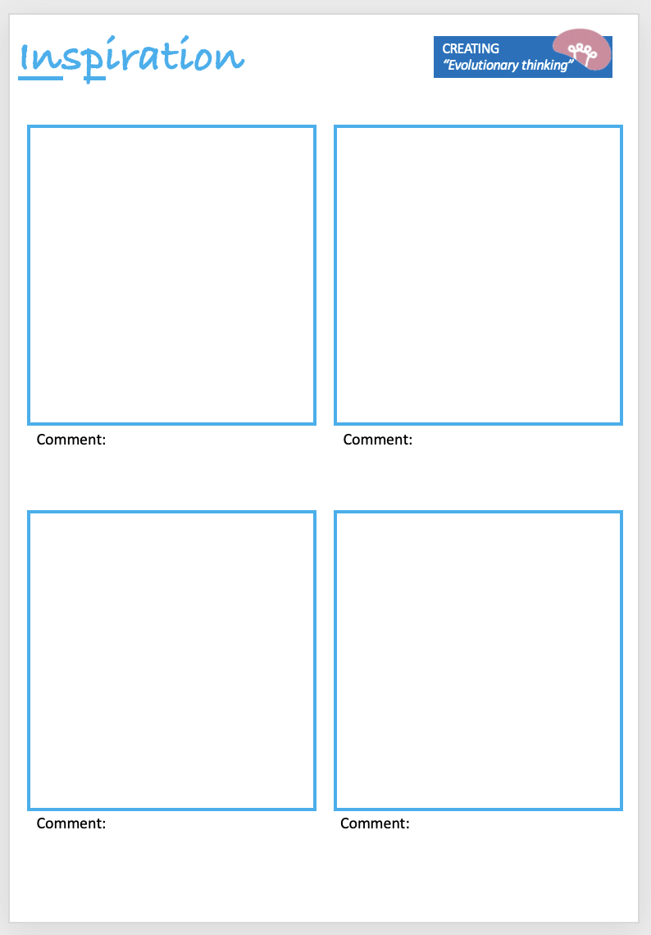
Collect some images to help you while you design
Notes:
Teacher can add mind map in space on the board

Slide 27
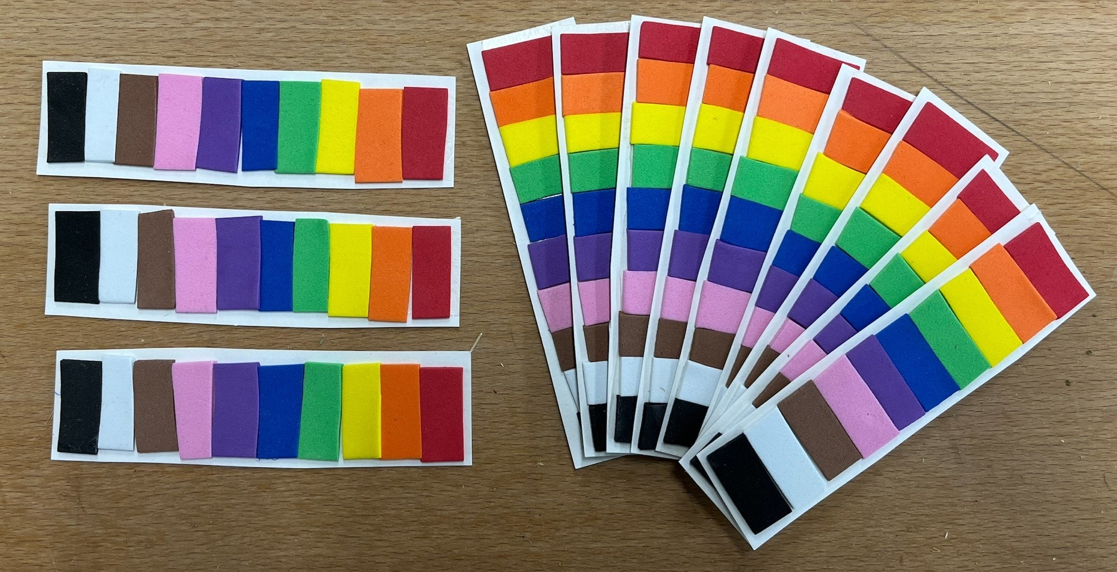
Foam Colour Palette
HPL: Analysing.
On the left is an image of all the available colours of foam that you can use.
You will have to carefully consider what colours are available when creating your designs.
These will be available to refer to on your tables.

Slide 28
Ideas
CREATING
“Evolutionary thinking”
Comment:
Comment:
Comment:
Comment:
Notes:
Teacher can sketch in space on the board

Slide 29
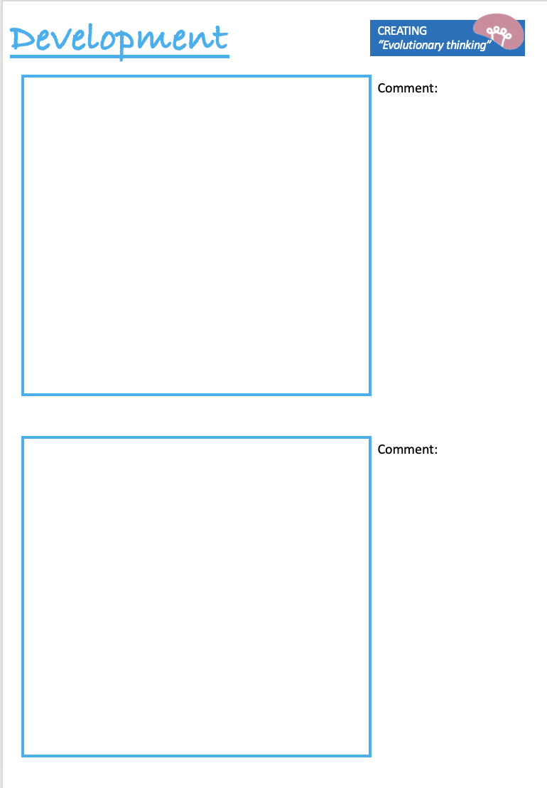
Notes:
Teacher can sketch in free space on the board

Slide 30
Final design
CREATING
“Evolutionary thinking”
Explain how the final design has been improved from the original idea. Please explain your decisions:

Slide 31
Cutting foam – using templates
HPL focus - REALISING
Accuracy

Slide 32
Cutting foam – using templates

Slide 39

HPL focus - REALISING

Slide 40
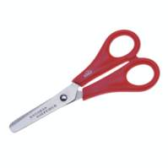

Cutting foam – scissors or scalpel?
Cutting AROUND an object or shape?
Cutting INSIDE an object or shape?

Slide 41
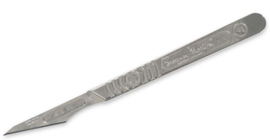
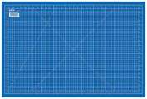
Using a scalpel – Risk assessment
Hazard | Control measure
You can cut your fingers or hands | Always make sure your hands are away from the direction in which you are cutting Always use a cutting mat – this will stop the work from slipping Always use the scalpel the correct way round Always hold the scalpel as shown Try to cut in one direction – move the work not the angle of your cut!
You could cause harm to somebody else | Be aware of your surroundings Only one scalpel per person When you have finished with your scalpel put it back in the box Always carry your scalpel from the box straight to your table with the blade pointing DOWN – Don’t walk around the room with it

Slide 42
Self and peer evaluation

Slide 43
HPL focus - CREATING

Slide 44
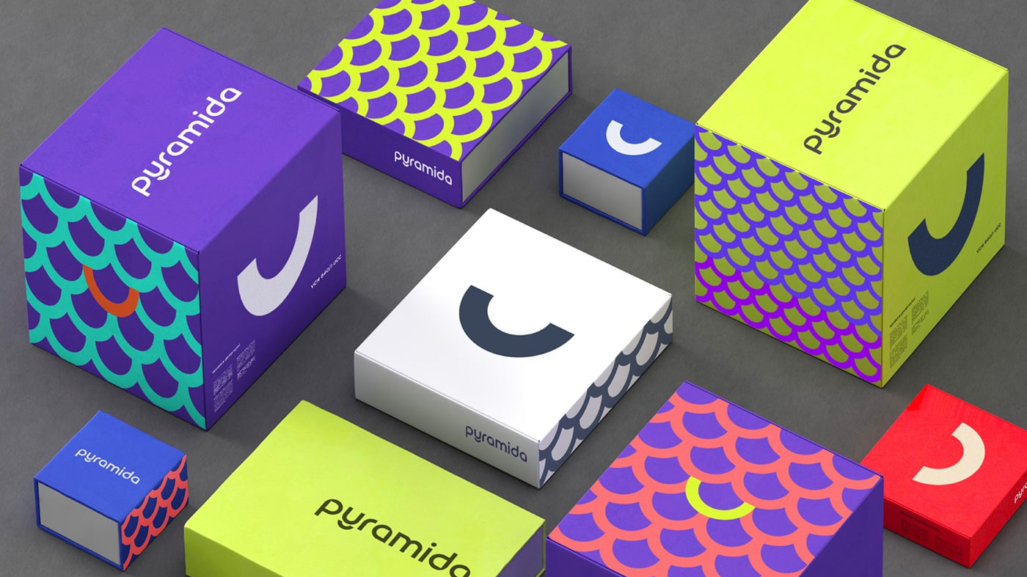
What are the purposes of good packaging design?

Slide 45
Visually appealing.
Provide information about the product.
Protect the product from damage.

Slide 46
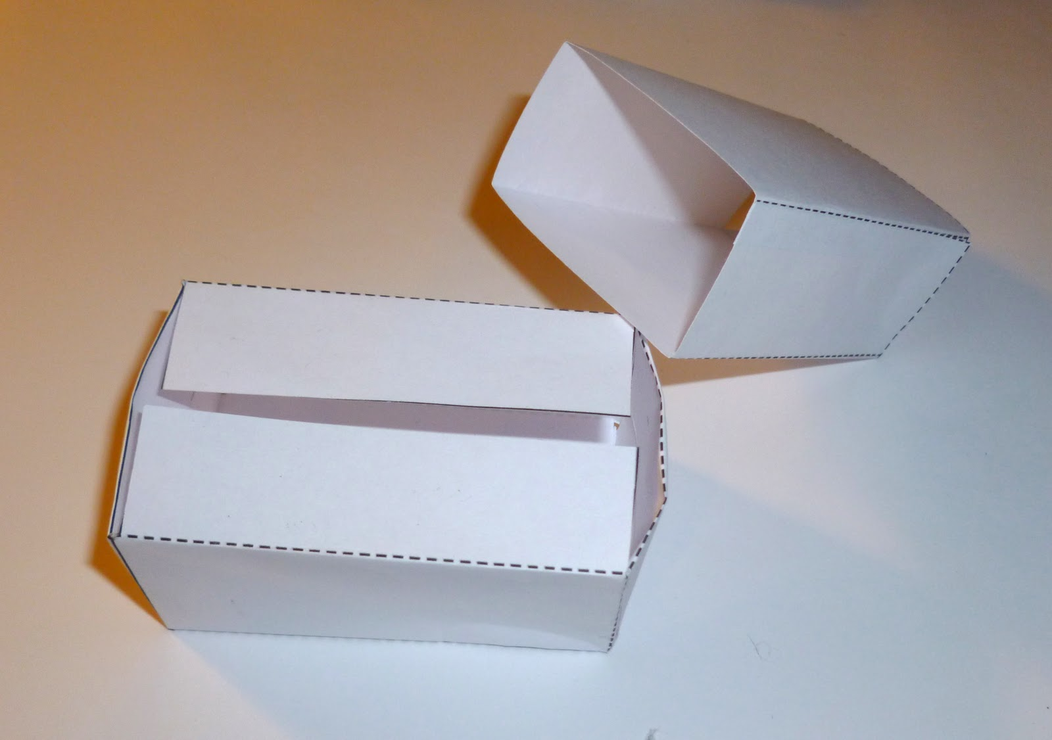
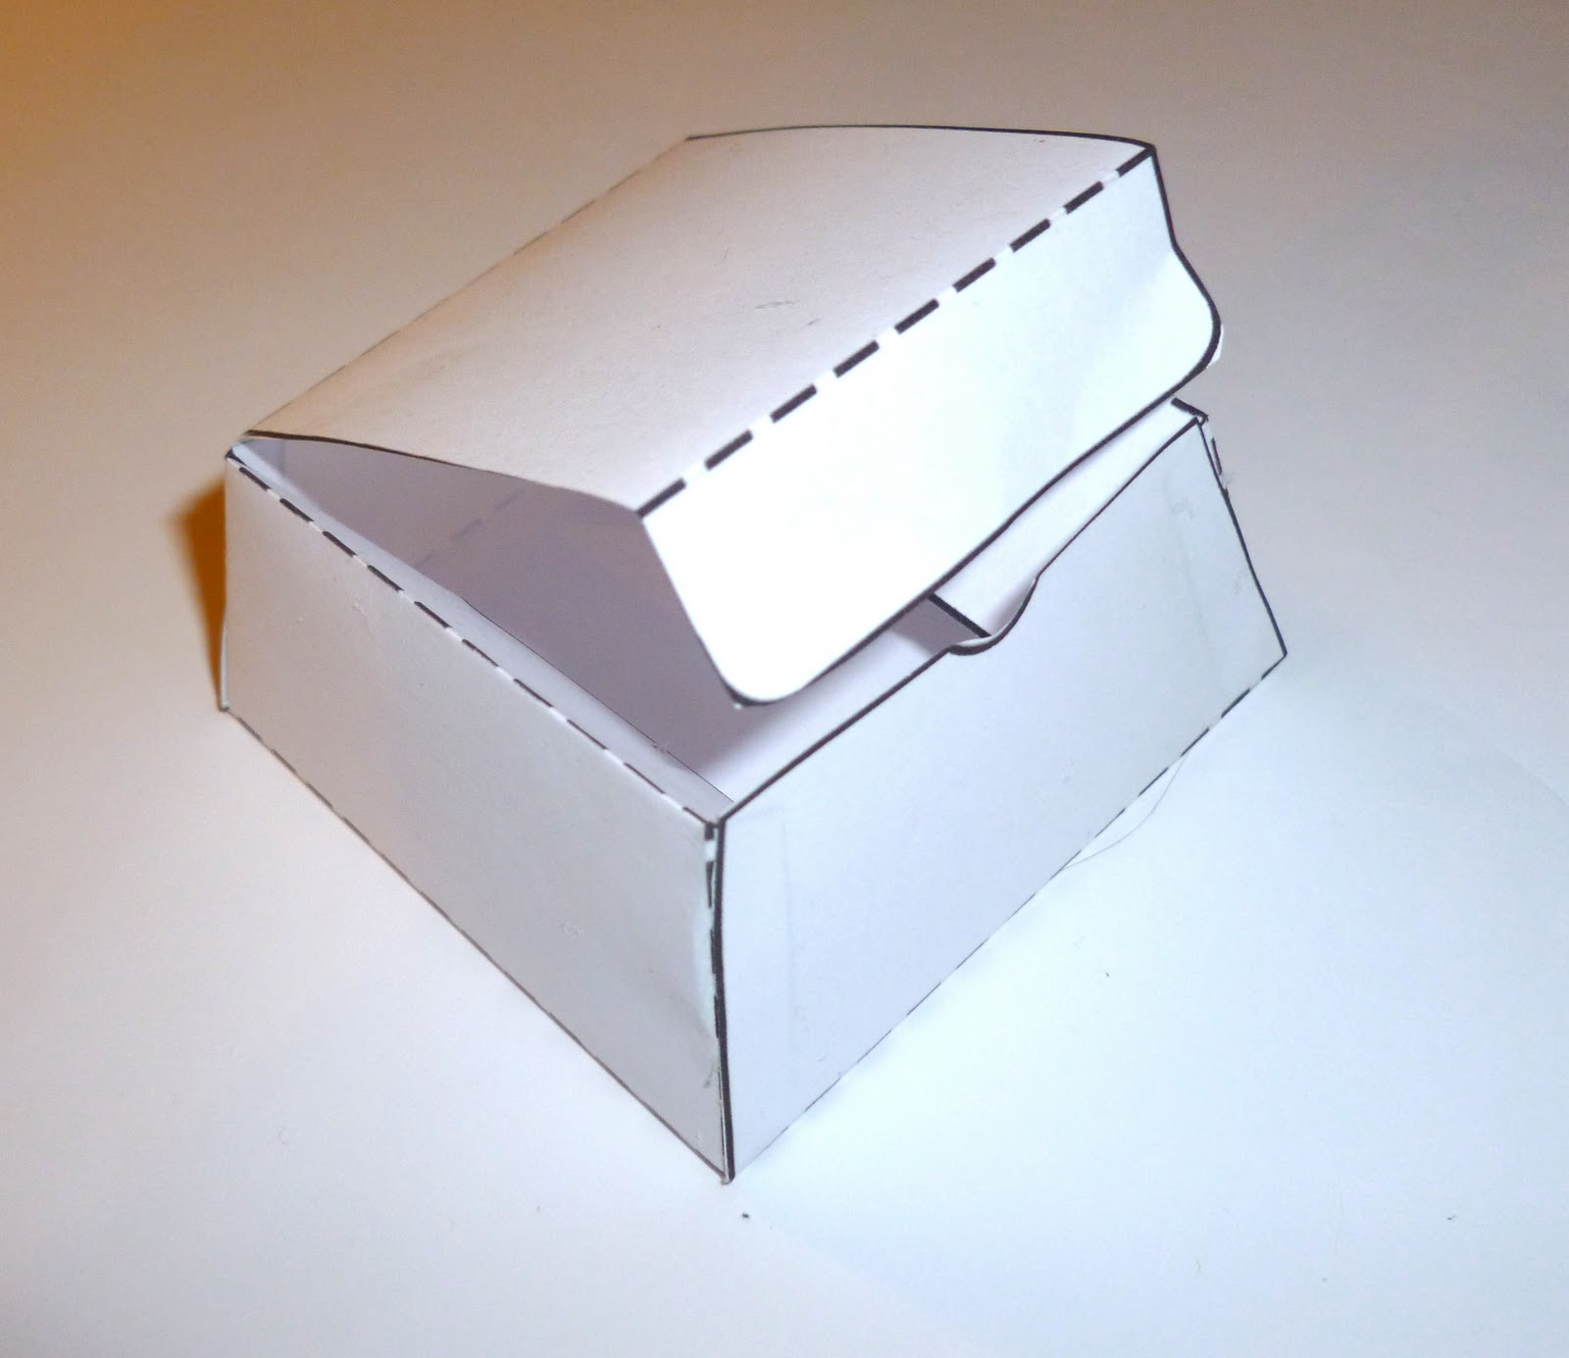
Packaging Prototype.
HPL focus - CREATING
What do the dashed lines represent?
Why might a prototype be useful?

Slide 47


Name:
Creating – Fluent thinking
Linking – Connection Finding
Packaging Prototype Ideas
1. List 15 words that you could associate with your design in the box below.
2. Use the area below to sketch some doodles/ideas based on your words from the list.
3. Use this area to develop your sketches and think about how they will look on your packaging.

Slide 48
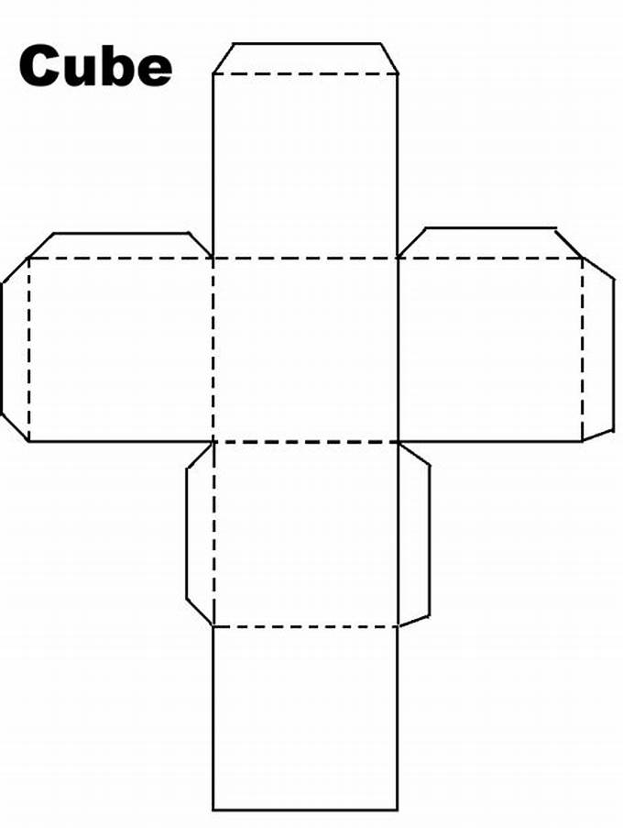
Creating Prototype.
Flaps
What is the correct term for the image on the right?
Why is it important to include the flaps on the sides of the squares?

Slide 49



Packaging Standards.
Kitemark
Barcode
Logo
Kitemark - is a UK product and service quality trade mark which is owned and operated by the British Standards Institution (BSI).
Barcode – is a series of parallel lines in varying widths, which are used to identify stock.
Logo - is a graphic mark, emblem, or symbol used to aid and promote public identification and recognition.

Slide 50



Logo Design: Making an effective logo.
ANALYSING
Critical thinking
Think Pair Share:
Discuss the following with your table:
Do you recognise these logos?
What similarities do these logos have?

Slide 51

JOB LIST:
Ensure both sides of bat are finished. (foam on both sides).
Ensure handle is sanded until smooth.
Make sure that design sheet is finished.
Evidence PowerPoint Sheet is finished.
Photograph your work. With WWW and EBI.
Upload to assignment.
Meta Thinking-
Self Regulation.

Slide 52
Do Now Task -Examples of self evaluation.
WWW What Went Well | Example: I used the coping saw to cut the template accurately.
EBI Even Better If | Example: It would be better if I used the fret saw, to cut the template of the bat more efficiently.
QC Quality Control | Example: I made sure that the template was positioned correctly in the vice, to ensure that the template was stable whilst I was cutting the template.
Next steps Plans for further improvement | Example: I will need to use the sanding block and half round file to smoothen the edges of the bat.
Meta Thinking-
Self Regulation.
Task:
Highlight or underline the key words and processes.

Slide 53
Writing frames for self evaluation.
WWW What Went Well | I used the coping saw to.. I was successful using the sanding block to I ____ on my handle by using the half round _____.
EBI Even Better If | I could improve my bat by ______ edges of my bat. My bat would look better if _______. The design on my bat could be improved even further if _____.
QC Quality Control | To ensure that I cut my bat accurately, I had to ________. One of the questions I asked myself to ensure quality was ________. I am confident in the quality of my ______, because I _______.
Next steps Plans for further improvement | For my next steps I will need to use _______ to ________ Going forwards, I am going to ________ Next lesson, I need to make sure that I ______
Meta Thinking-
Self Regulation.

Slide 54
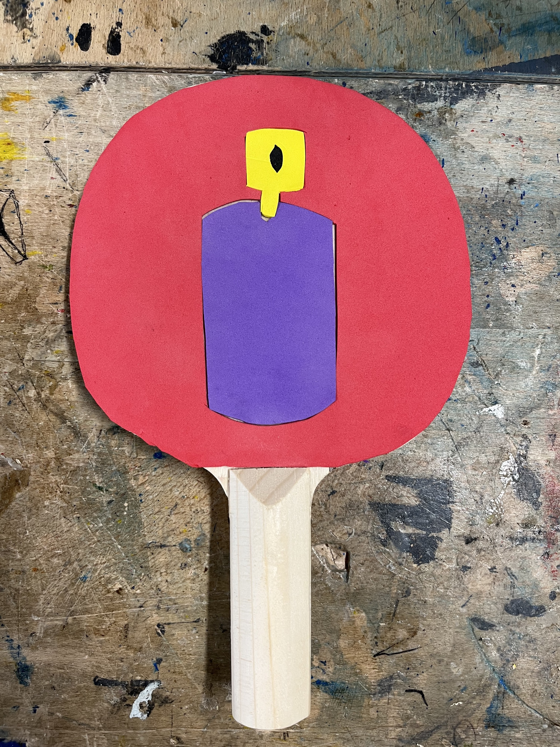
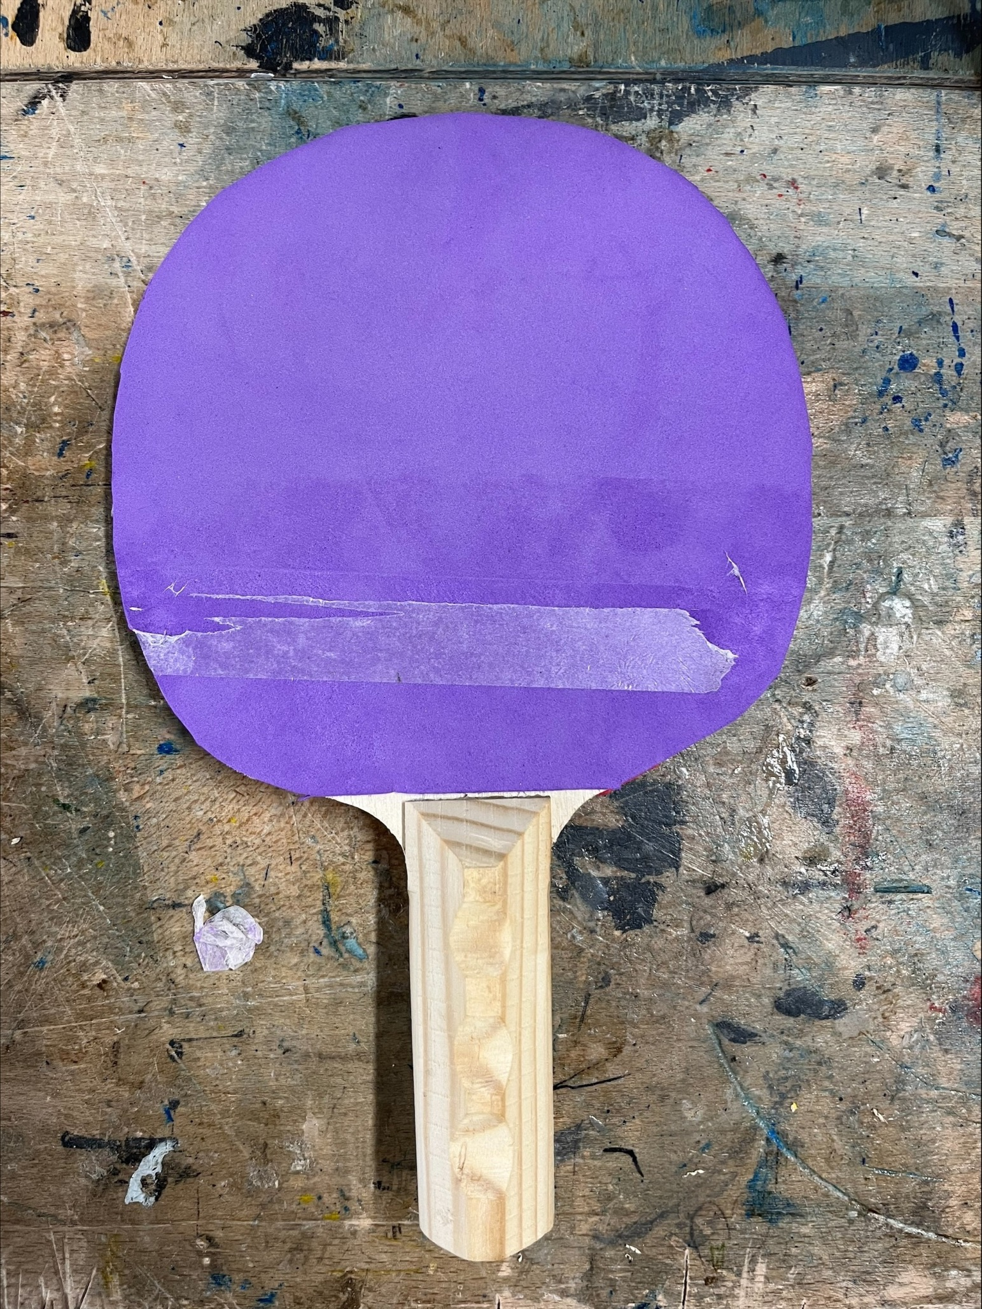
Do Now Task: Can you identify key things that this presentation sheet has?
Table Tennis Presentation sheet. EXAMPLE
WWW: Overall, I am very happy with the outcome of my table tennis bat.
My designs have been influenced by my interests in art and graffiti which is why I chose a spray can as one of my designs.
I used a coping saw to cut out the template of my bat. I also learned how to use a half round file and sanding block to smooth the edges of the wood.
EBI: If I was to create a new bat, I think that I would choose a different theme such as sport and I would make my designs bigger to utilise more space on the bat.
ANALYSING
Critical thinking

