Slide 1
Applying to CCS Sixth Form as an External Applicant

Slide 2
The application process
External Applicants can apply to our sixth form from midday on Friday 17th January and applications will close at midnight on Monday 17th February.
www.ccs.northants.sch.uk/admissions/year-12-sixth-form
or applicants can go directly to the form through this website: https://ccs.applicaa.com/year12

Slide 3
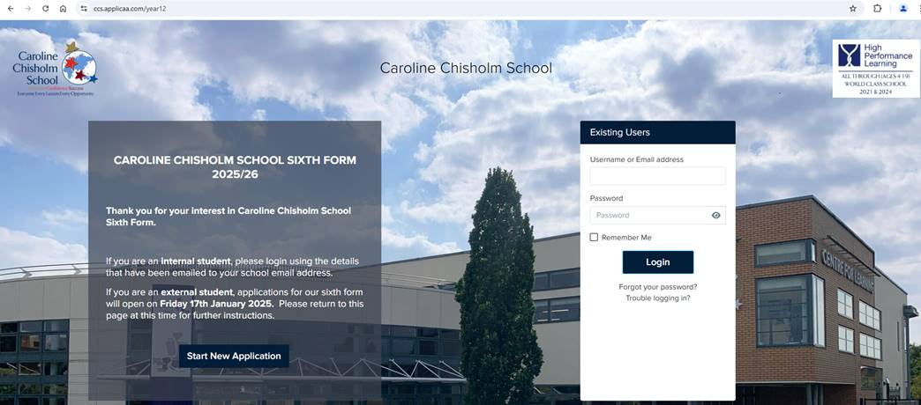
The application process
Start by clicking the ‘Start New Application’ button at the bottom left of the screen which will bring up this pop up…

Slide 4
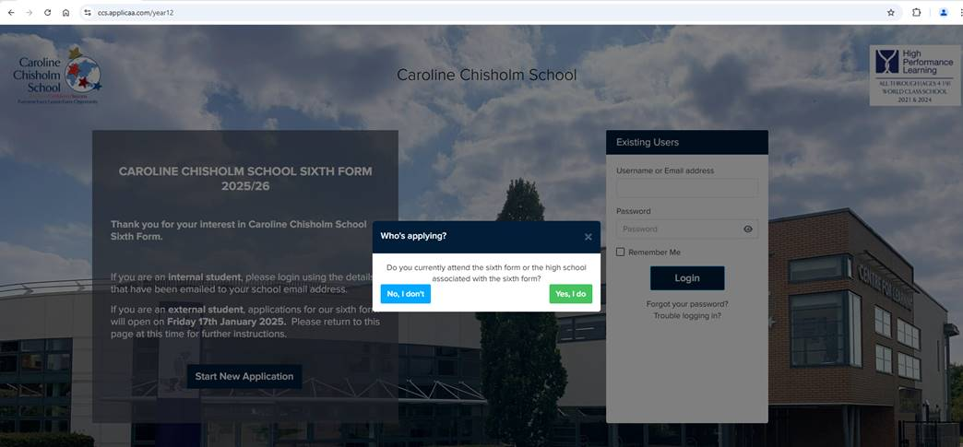
The application process
Click ‘No, I don’t’ and then the applicant will need to create an ApplicaaOne profile in order to access our application form

Slide 5
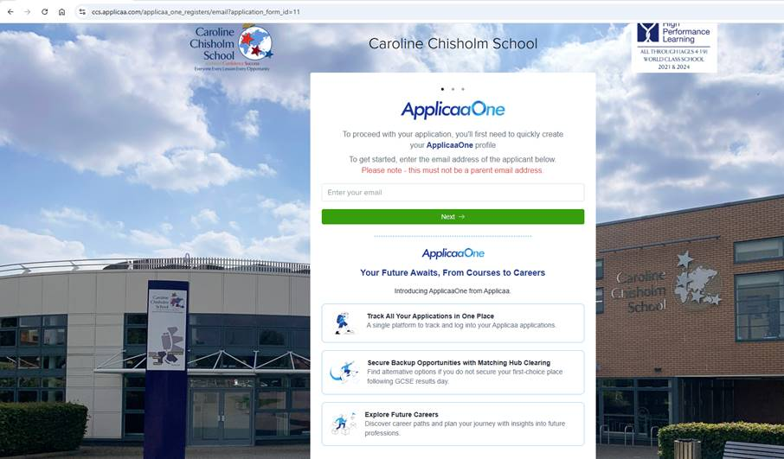
The application process
External users should NOT use their current school email address in case they cannot access this over the summer holidays. Instead, they should use a personal email address.
Students should be completing the application form, not parents.
We will be sending out regular updates on options blocks, taster days and our enrolment process to this email address so students need to check their emails regularly.

Slide 6
Application process – down the line
Once the deadline has passed, we will be working through the applications and sending out conditional offers in March, this will be followed with an invitation to our Induction Day in late June.
Any queries or issues with the application process can be directed to our Admissions Manager, Mrs J Mutch at admissionsteam@ccs.northants.sch.uk

Slide 7
Application process – down the line
On results day, the Sixth Form team will be at school to support students with their enrolment. For any students who have missed the entry requirements for their courses, we will offer advice and guidance on alternative options.
For external students, once evidence of your results has been uploaded to Applicaa, we will review them and contact you to confirm your place at CCS.

